Slide 1

My Learnings During the Bootcamp Training
By: Pragun Sood
Batch-6
14th August 2023 to 6th October 2023

Slide 2
Foundational Training
18th August to 28th August

Slide 3
Day 1 – 18th August
Introduction to Business Analysis.
Requirement Analysis – Functional and Non-Functional
Requirements Traceability
Waterfall vs Agile methodology
Introduction to Agile practices and Scrum
Sprints in agile
Roles in agile – Scrum Master, Product Owner, etc.

Slide 4
Day 2 – 21st August
Azure Devops
Creating Epic, User Story, Task, Sub-Task
Sprint Board
Product/Sprint backlog
Scrum fundamentals
Reports – Burndown, Burnup, & Velocity Chart

Slide 5
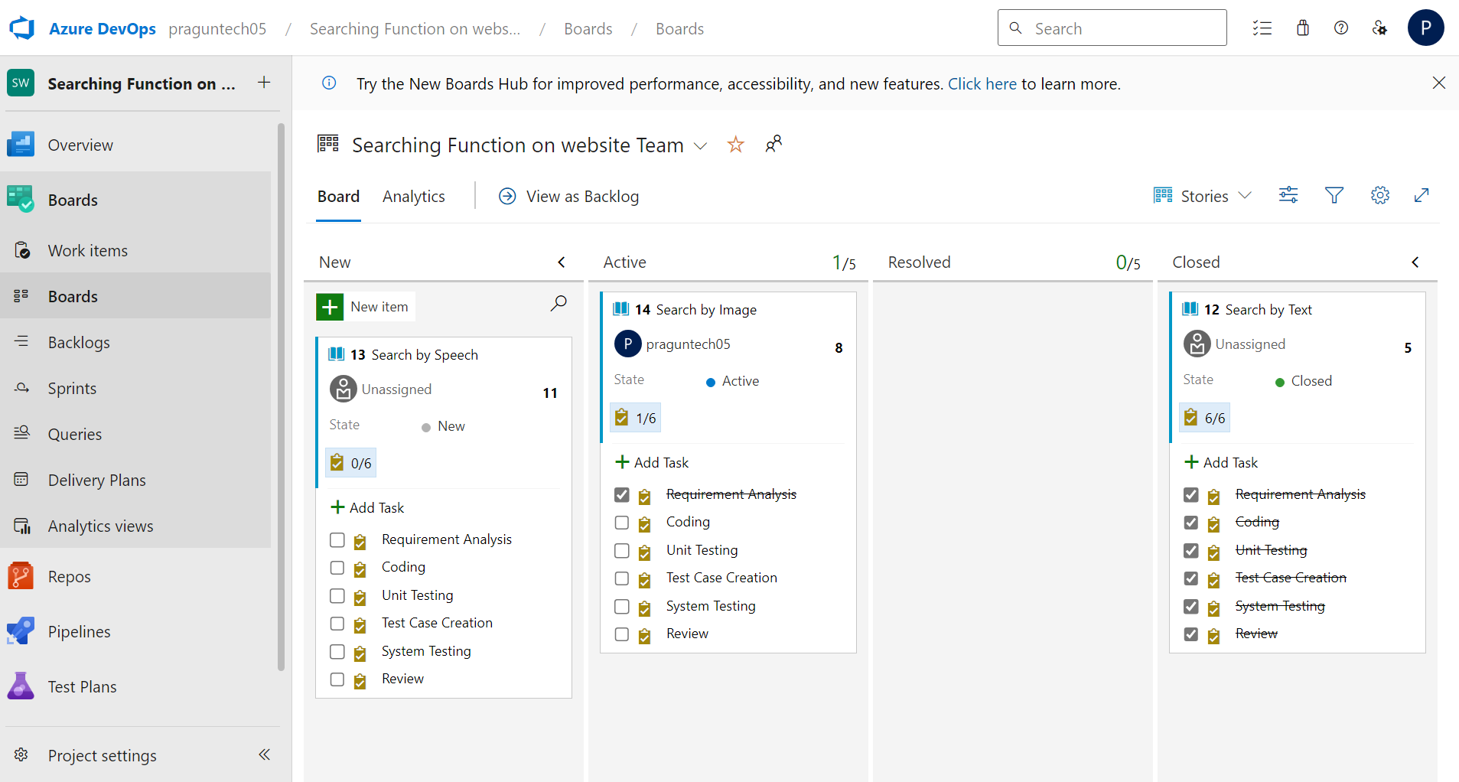
Day 2 – Azure Devops

Slide 6
Day 3 – 22nd August
What is DBMS
Types of Databases
SQL Normalization forms
PostgreSQL
SQL Commands – Create, Drop, Select, etc.
Types of Joins – Outer, Inner, Cross.

Slide 7
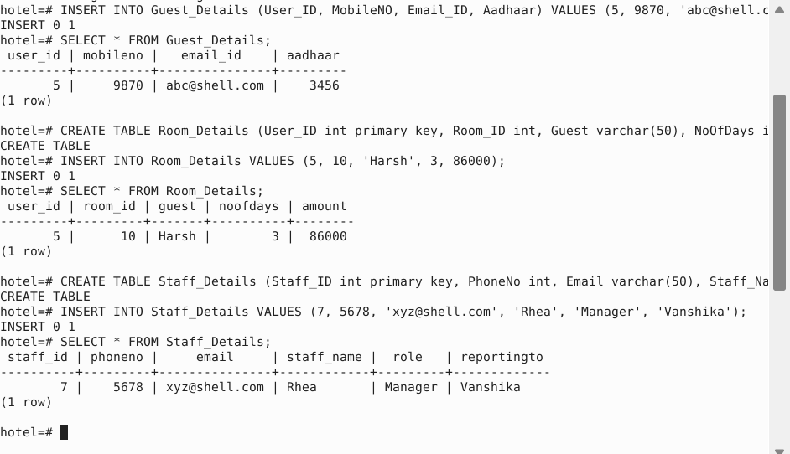
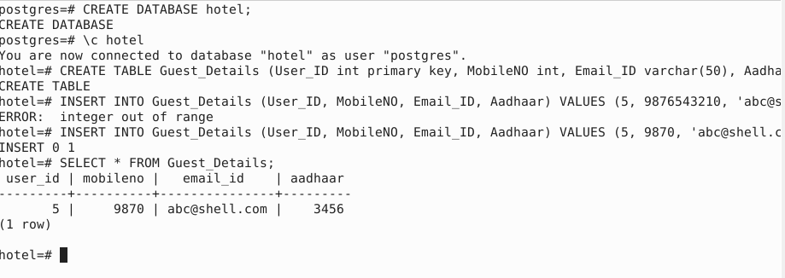
Day 3 – Postgresql

Slide 8
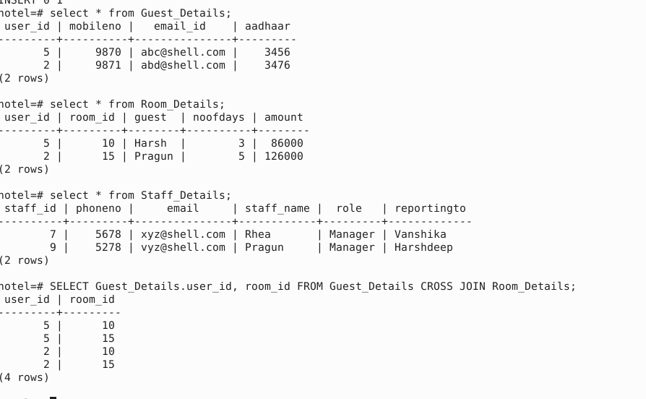
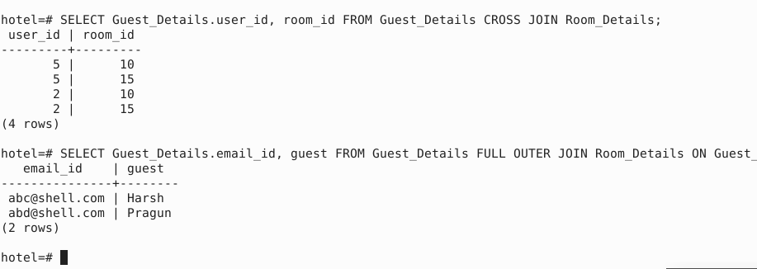
Day 3 – Postgresql

Slide 9
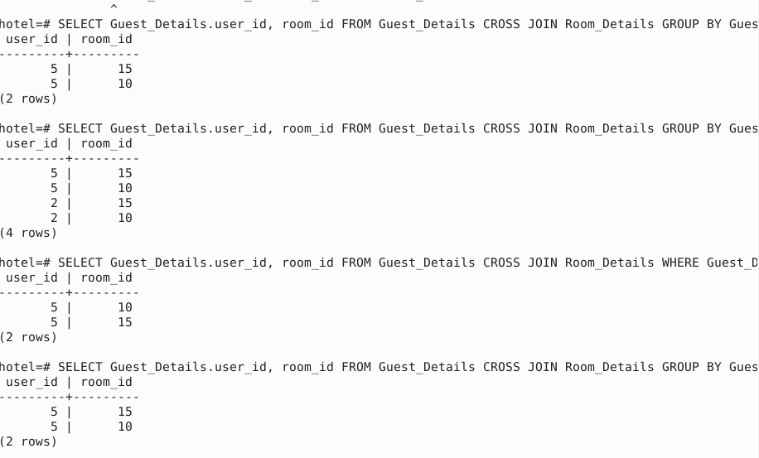
Day 3 – Postgresql

Slide 10
Day 4 – 23rd August
Software Testing – Static and Dynamic
Software Development Life Cycle (SDLC)
Software Test Life Cycle (STLC)
Testing Triangle
Types of Testing – Blackbox, Whitebox, Greybox
Functional and Non-Functional Testing
Automation Testing

Slide 11
Day 5 – 24th august
Devops – Lifecycle, Principle
Types of environment
Benefits of Devops
Continuous Integration (CI)
Continuous Deployment (CD)
Github Actions – Workflows, event, jobs, actions, runners

Slide 12
Day 6 – 25th august
Cloud Computing
Cloud Service models – SaaS, PaaS, IaaS
Cloud Computing Service Layers
Virtualization – Virtual Machines
Advantages and Disadvantages of Cloud Computing
Github Actions – yml file
Azure – VM creation

Slide 13
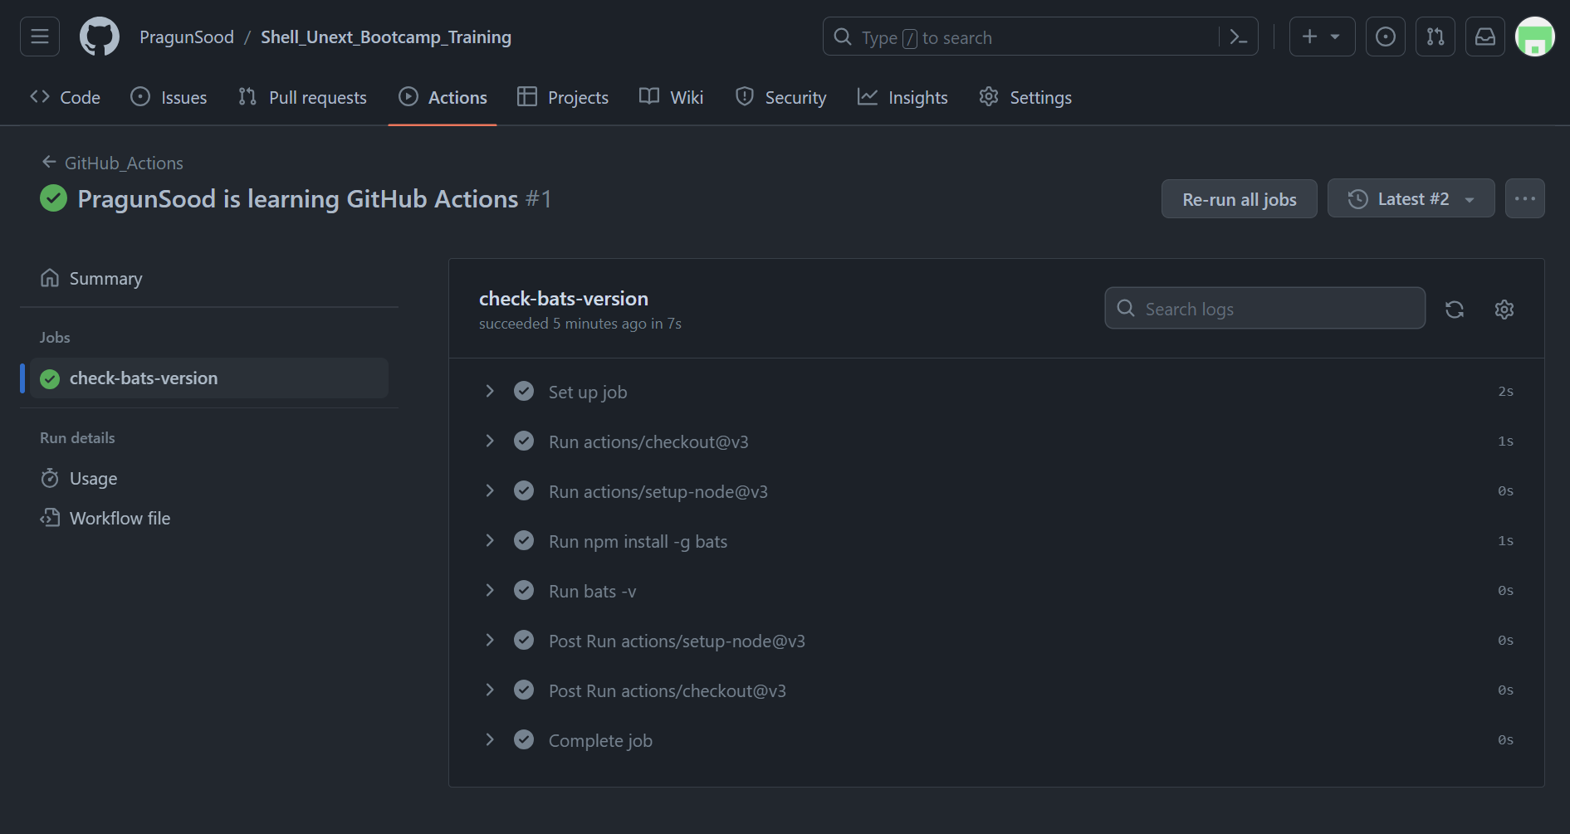
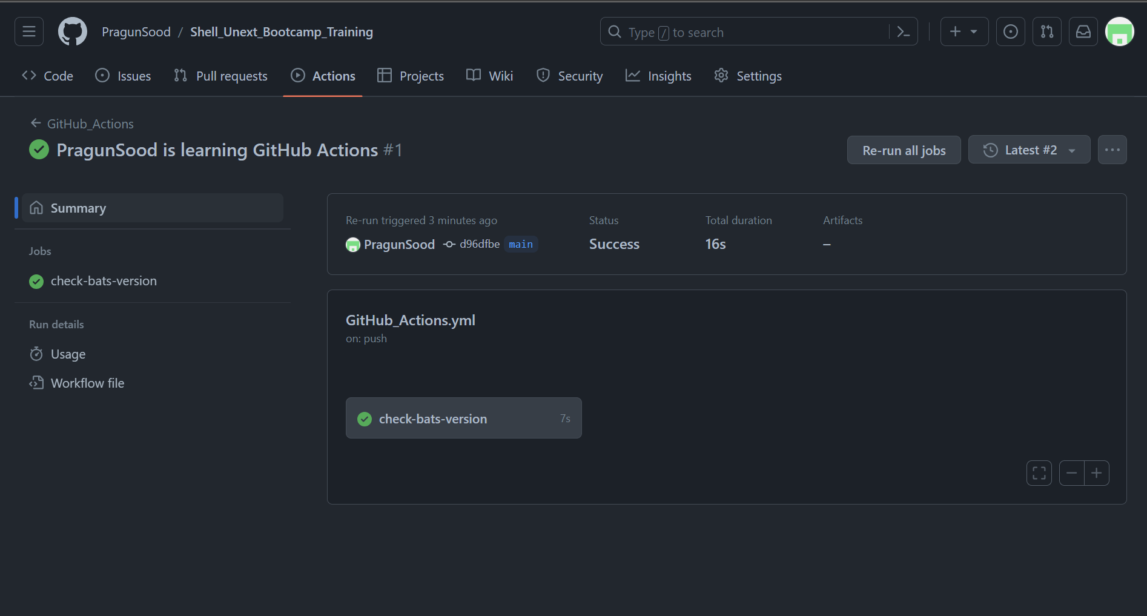
Day 6 – Github actions

Slide 14
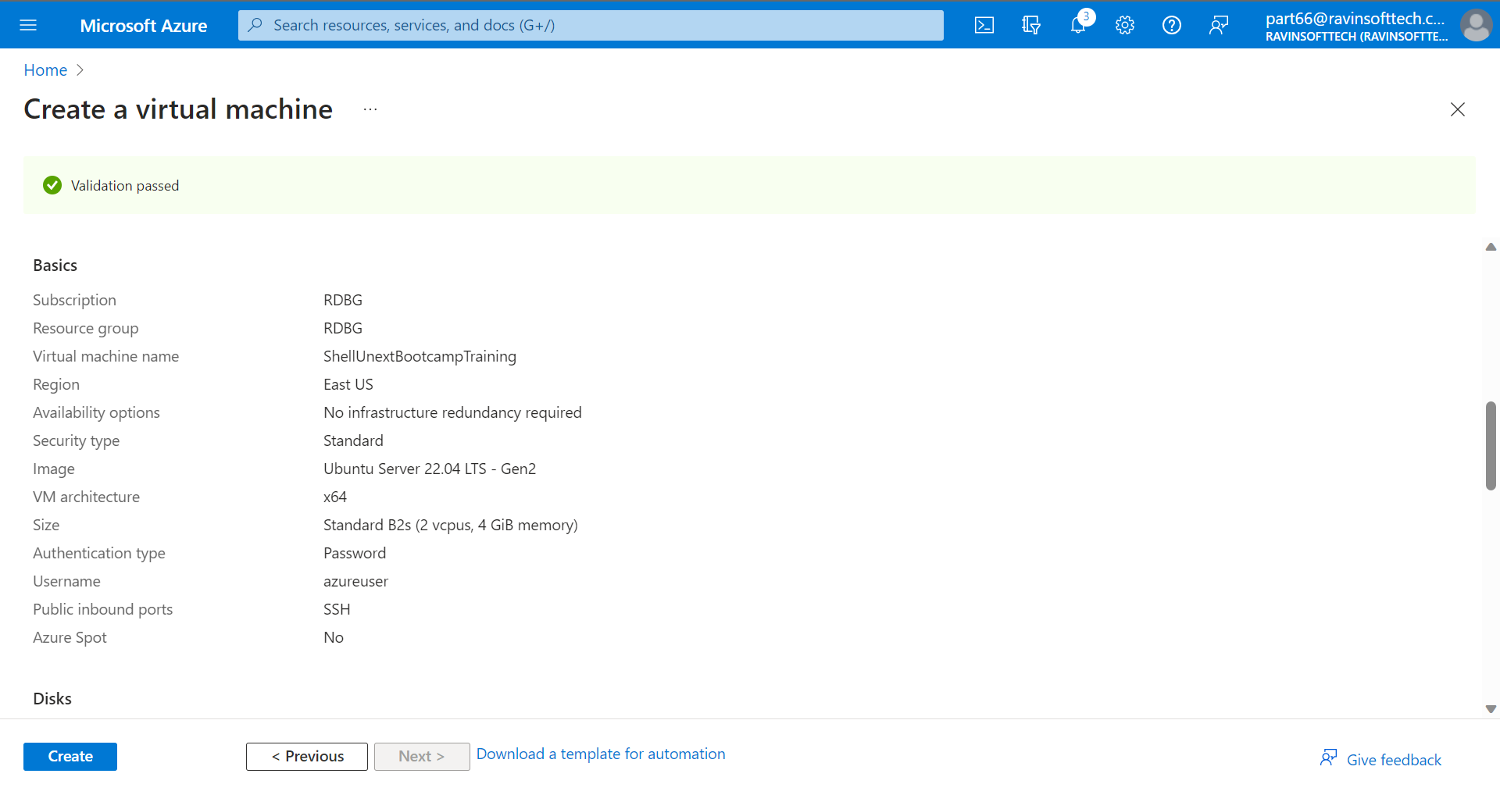
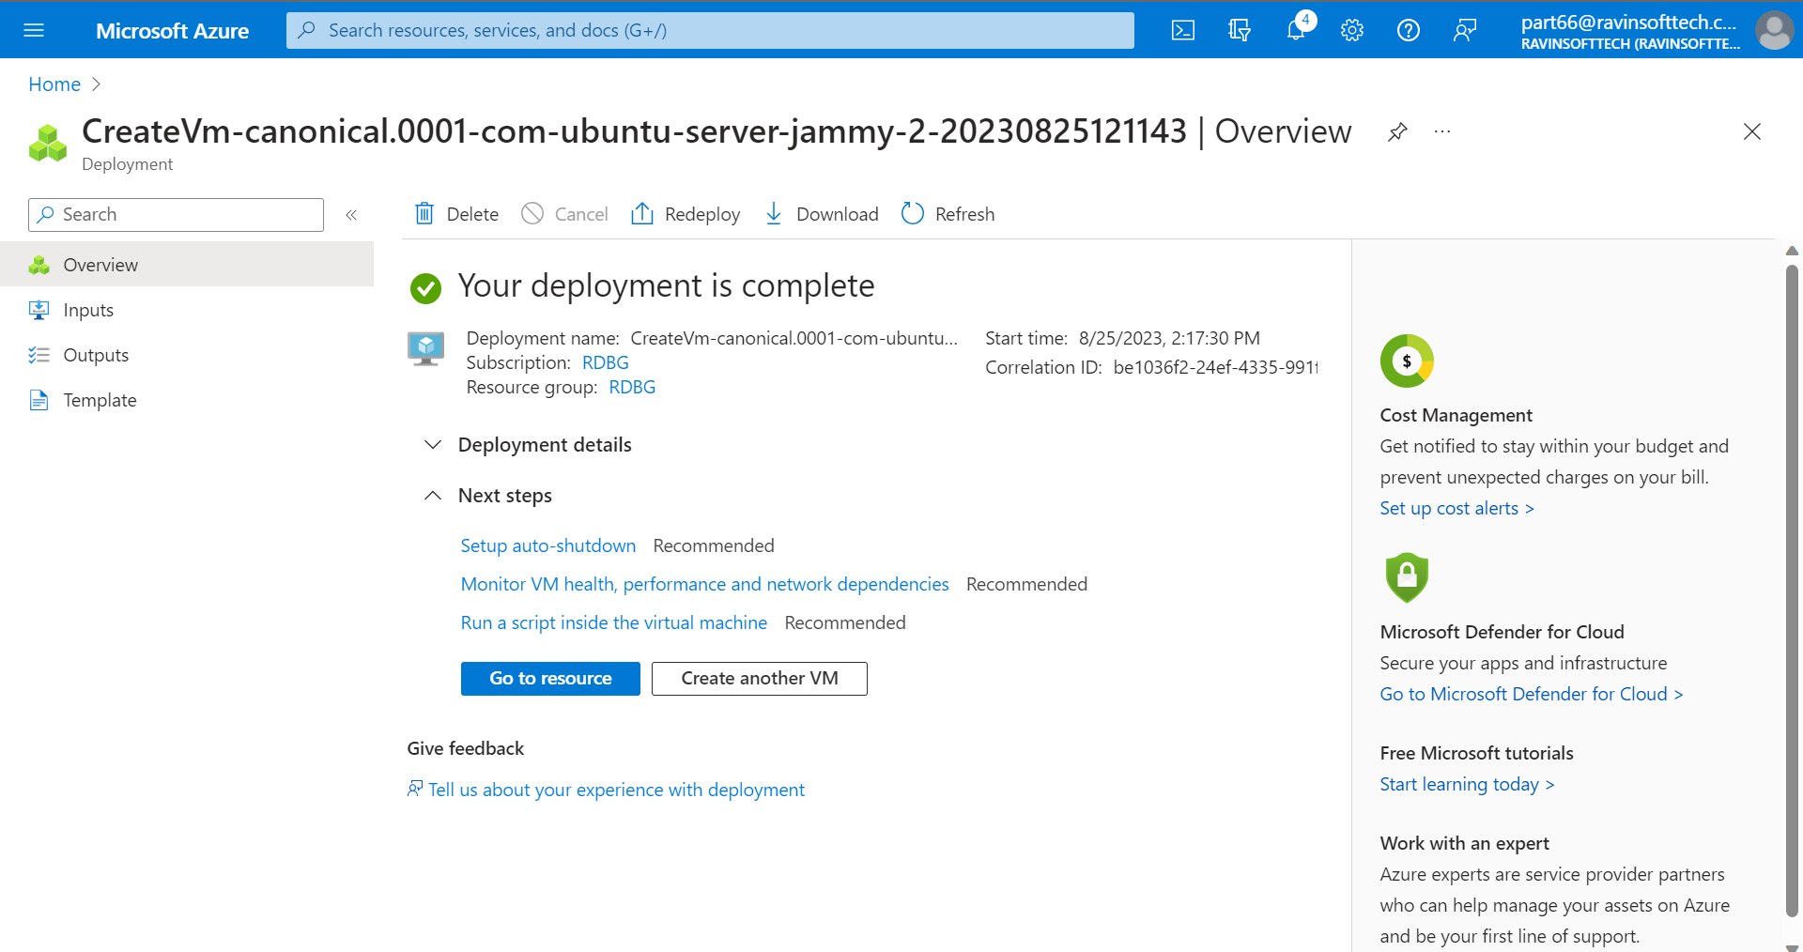
Day 6 – Azure VM Creation

Slide 15
Day 7 – 28th August
Case Study – Deployment of Java Spring Boot App
Azure Devops
Azure VM
Azure Web App services
GitHub – fork, feature branch, pull request, merge
GitHub Actions – Automate Workflow
Docker – make docker image and dockerfile
Maven – run maven package
Prometheus – to monitor local environment

Slide 16
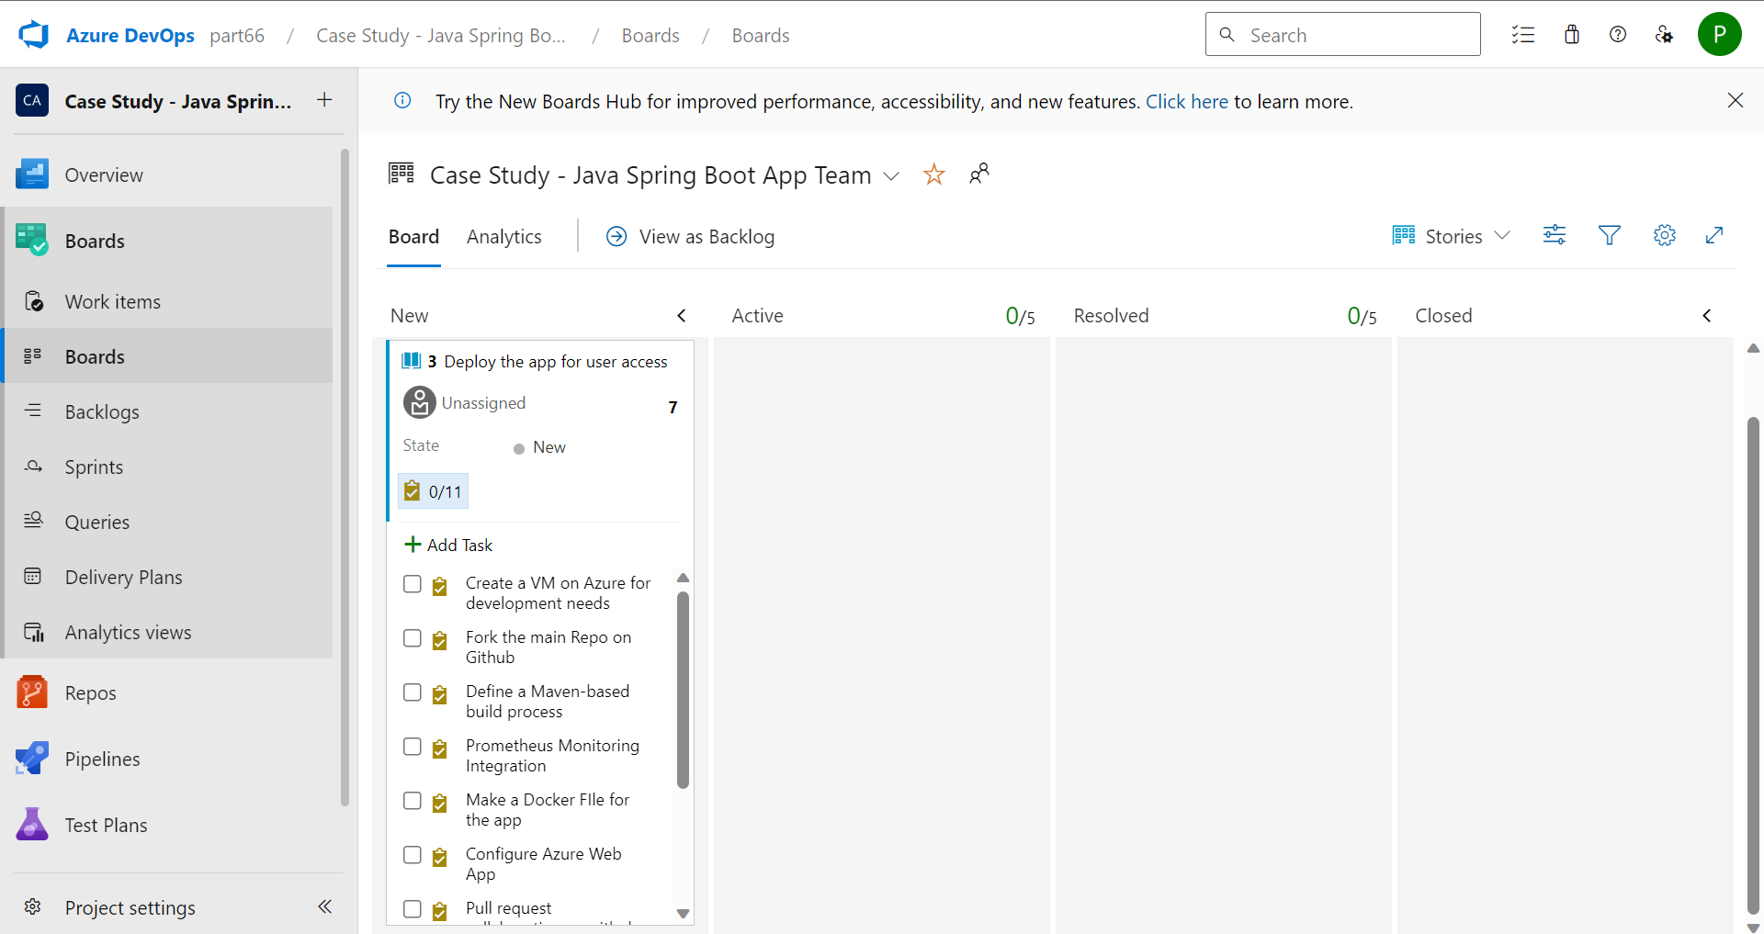
Day 7 – Case study - devops

Slide 17
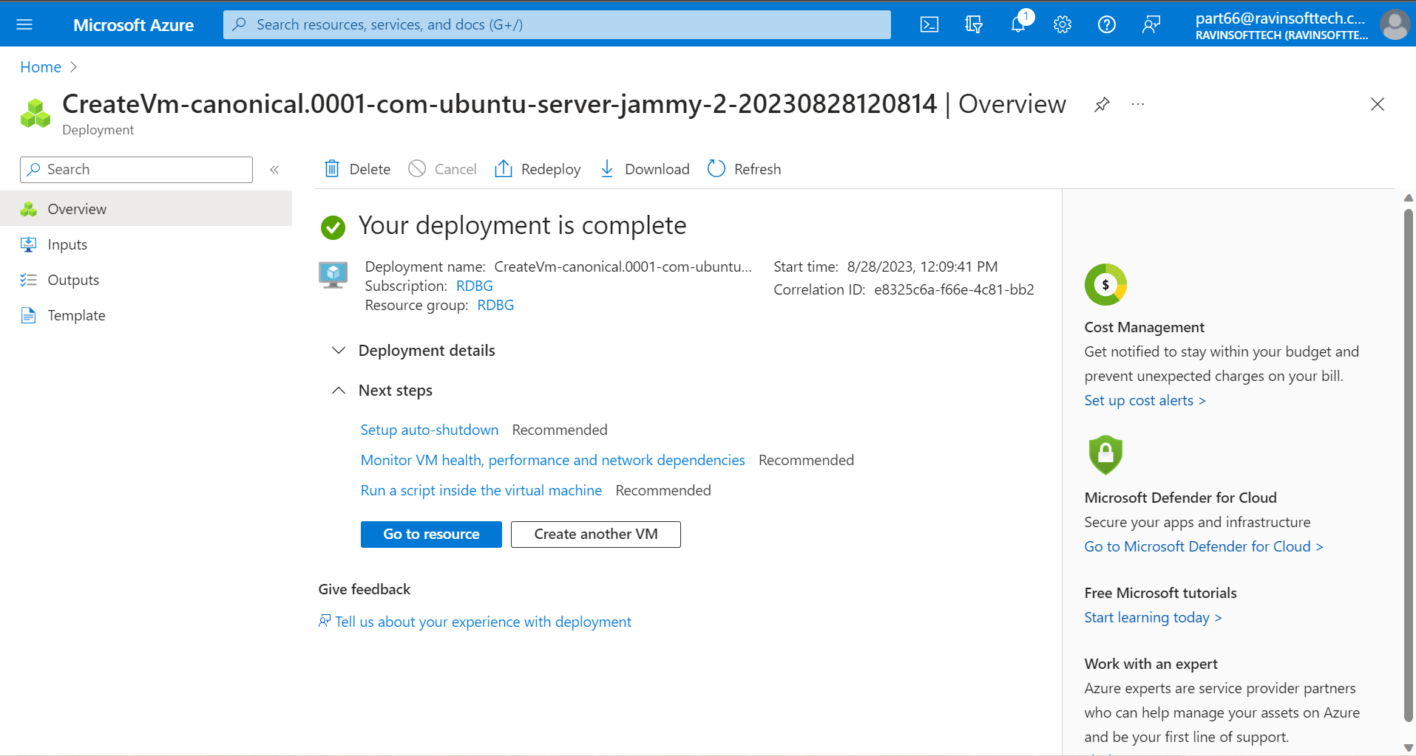
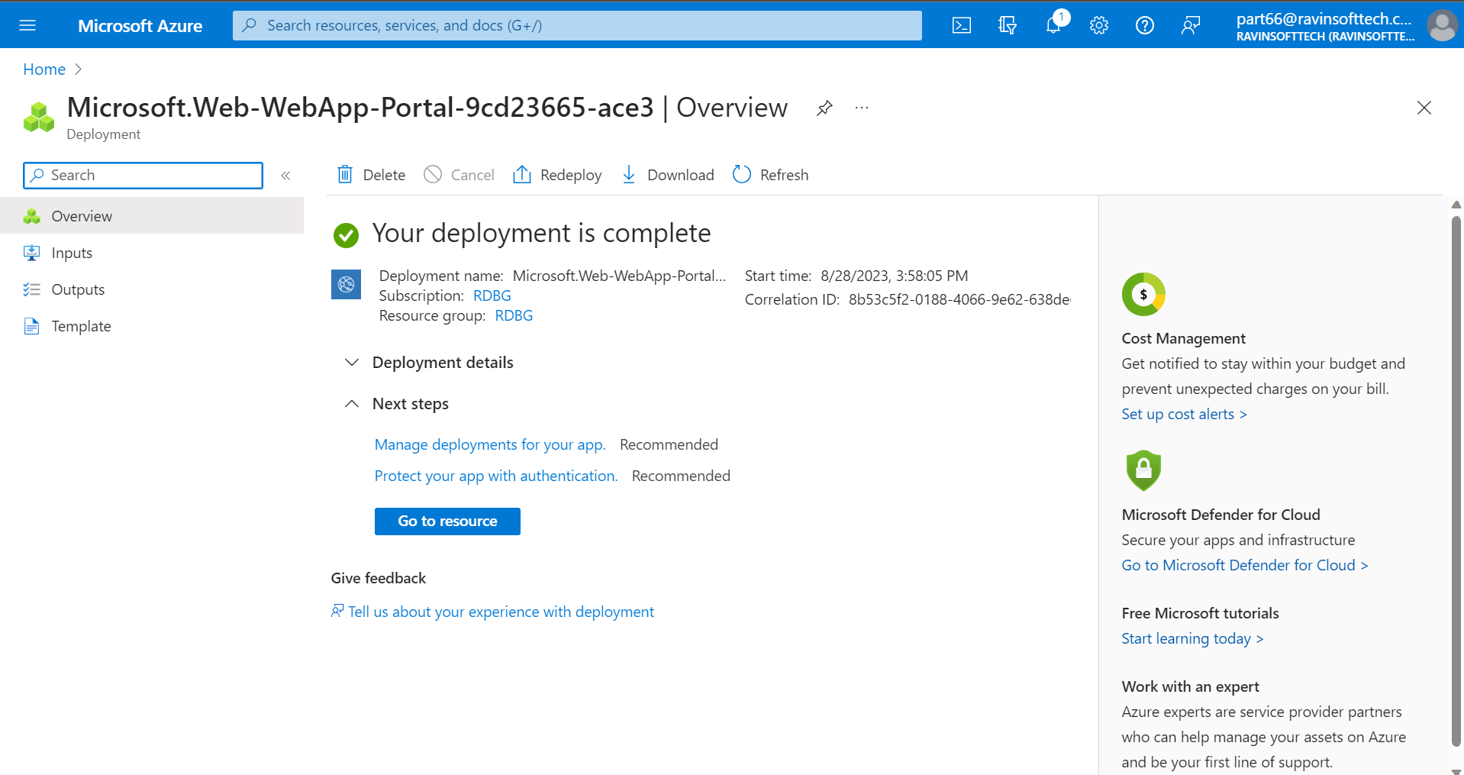
Day 7 – Case study – Vm and Webapp

Slide 18
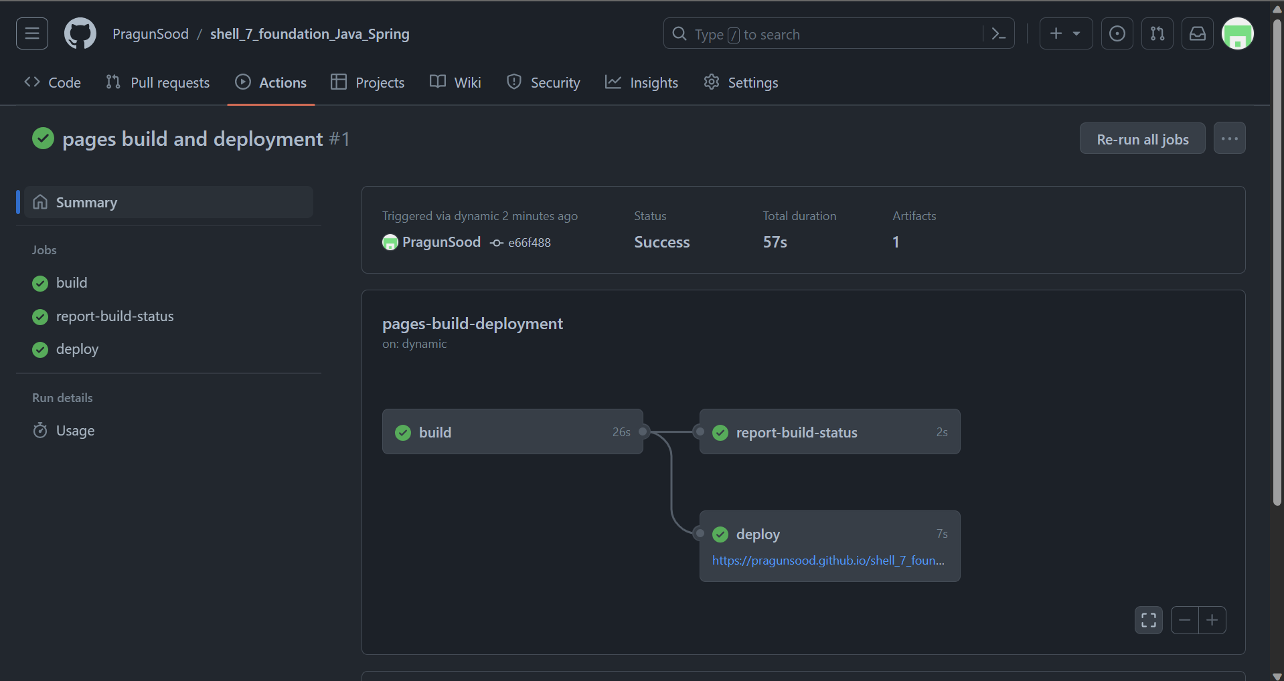
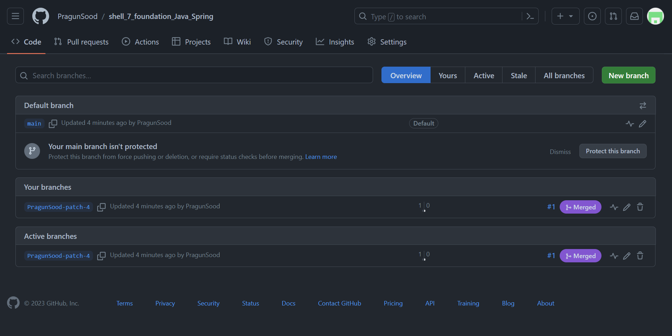
Day 7 – Case study – Github

Slide 19
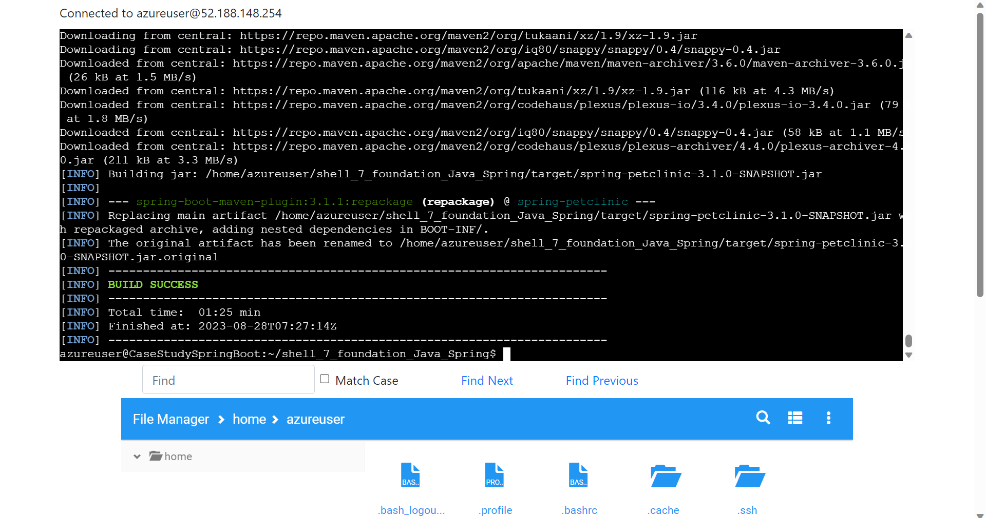
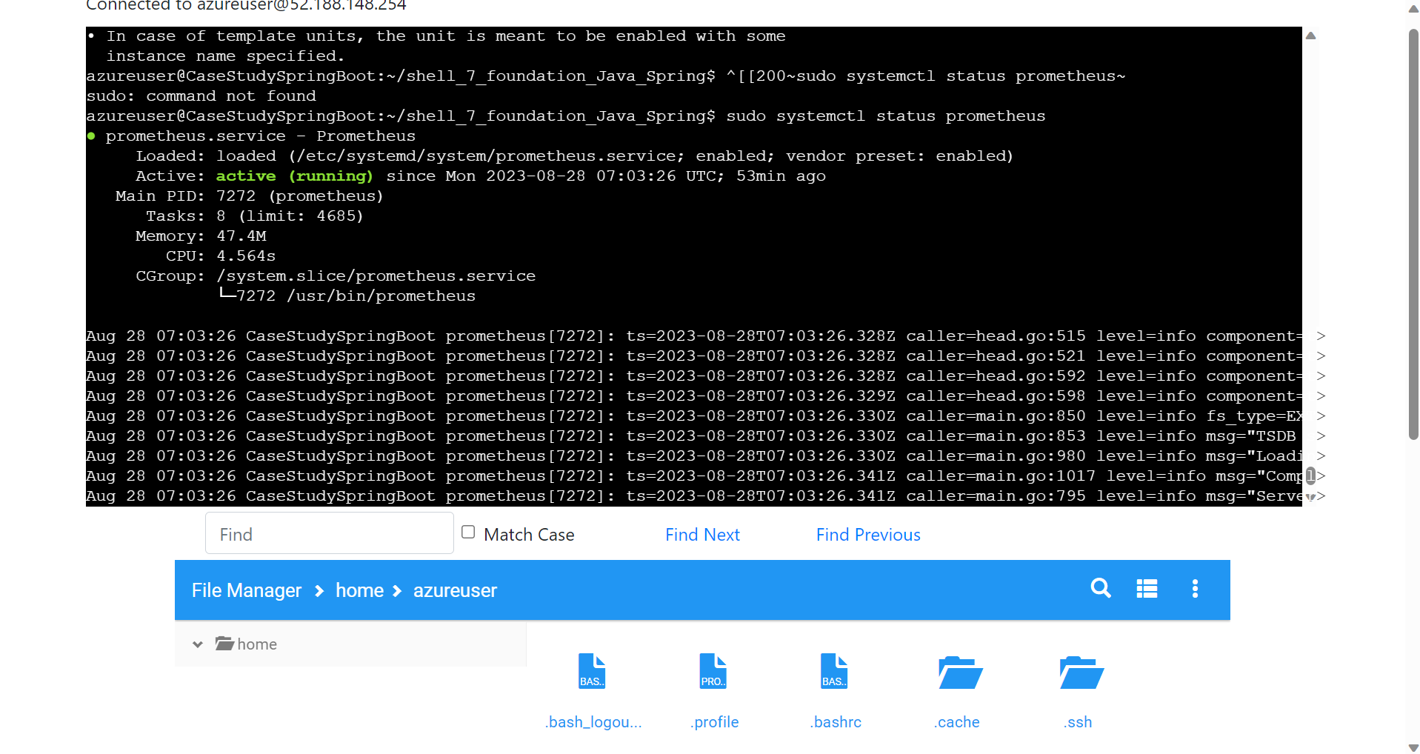
Day 7 – Case study – Maven & Prometheus

Slide 20
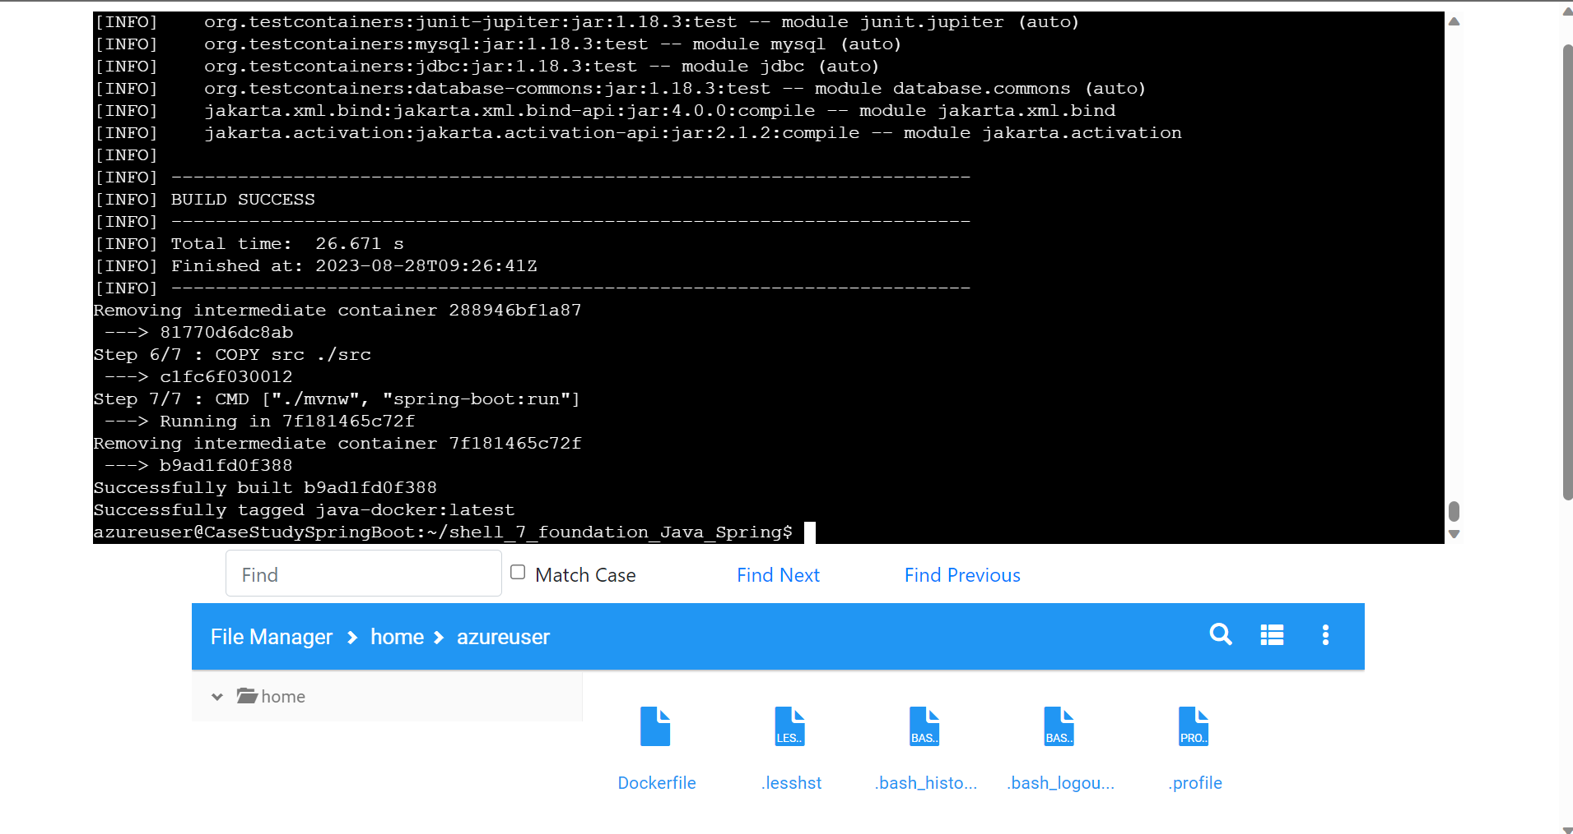
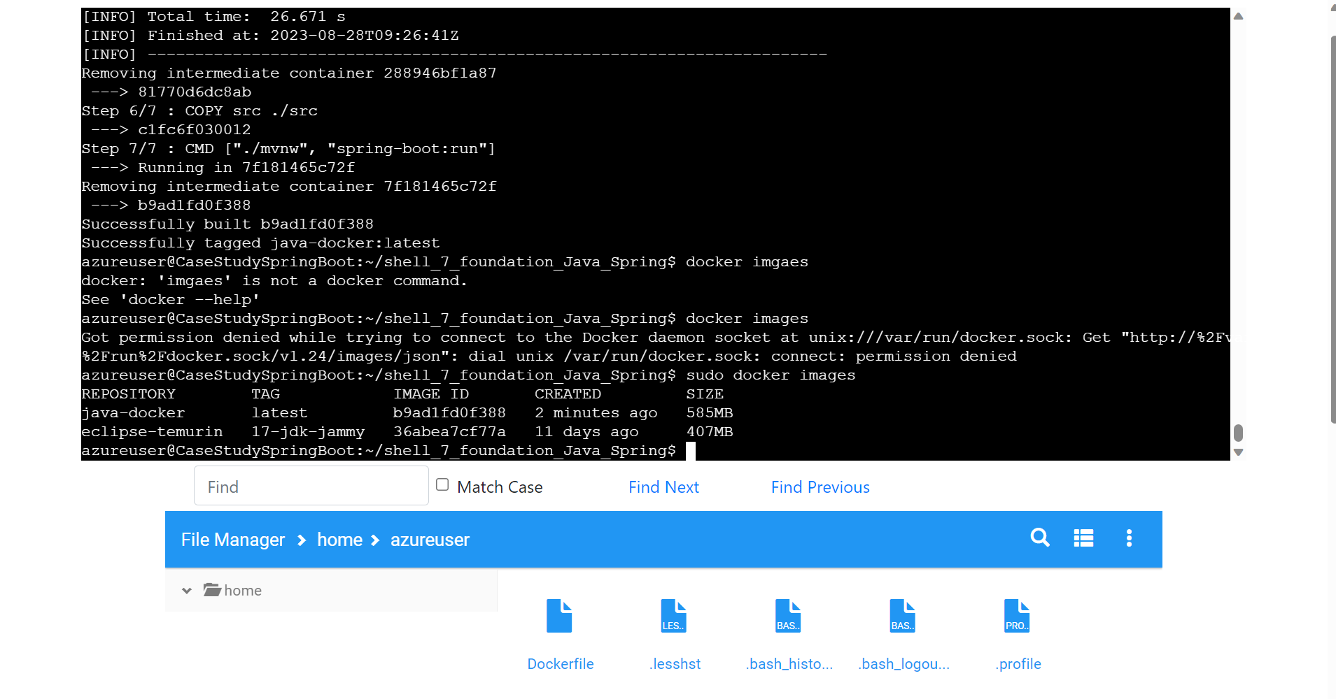
Day 7 – Case study – Docker

Slide 21
Custom Training
29th August to 06th October

Slide 22
Day 1 – 29th August
What is Data
Database (DBMS)
E-R Diagram
Normalization
Denormalization
Case Study on E-R Diagram
Case Study on Normalization
Dimension Modelling – Star, Snow Flake
Slowly Changing Dimension (SCD) – SCD1, SCD2, SCD3

Slide 23
Day 2 – 30th August
What is Big Data
Tools used for BDA – Hadoop, Spark
Types of Data Frameworks – Data Warehousing, Data Lake, Data Lakehouse
Types of Cloud – Private, Public, Hybrid
Benefits of Cloud
Types of expenditure – Capex, Opex
Types of Cloud Services – IaaS, PaaS, SaaS
What is a Resource Group

Slide 24
Day 3 – 31st August
Introduction to Azure SQL
What is a View
Types of SQL Languages – DDL, DML, DCL
What is a Schema
Azure SQL – Hands on
SQL Queries – Hands on

Slide 25
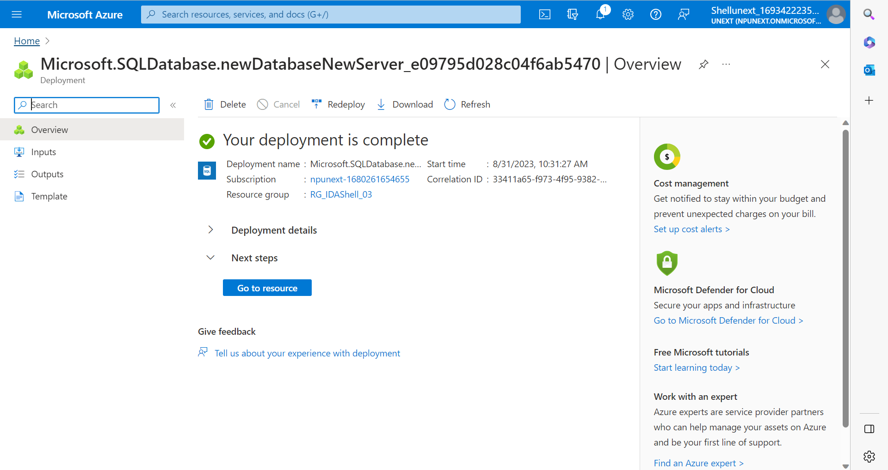
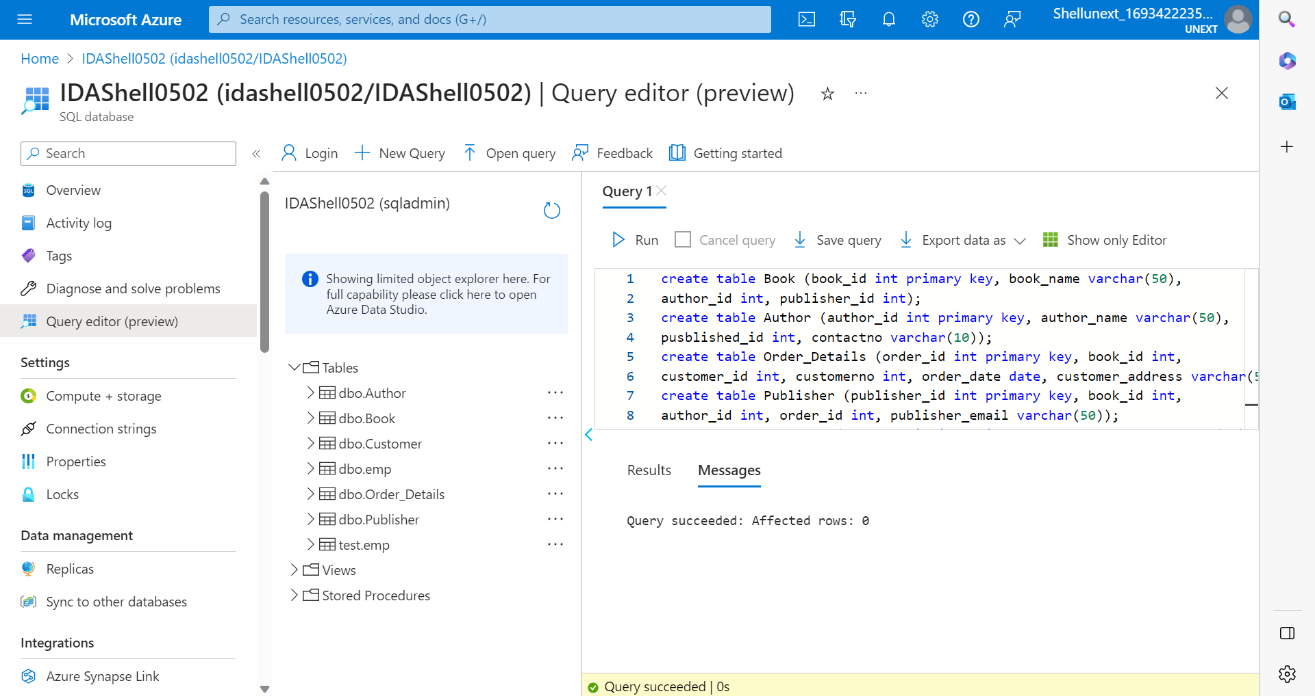
Day 3 – Azure SQL

Slide 26
Day 4 – 1st September
SQL Joins
SQL Queries
SQL Sub-queries
What is a View
What is a Stored Procedure
What is a Function
Azure SQL – Hands on
SQL Index

Slide 27
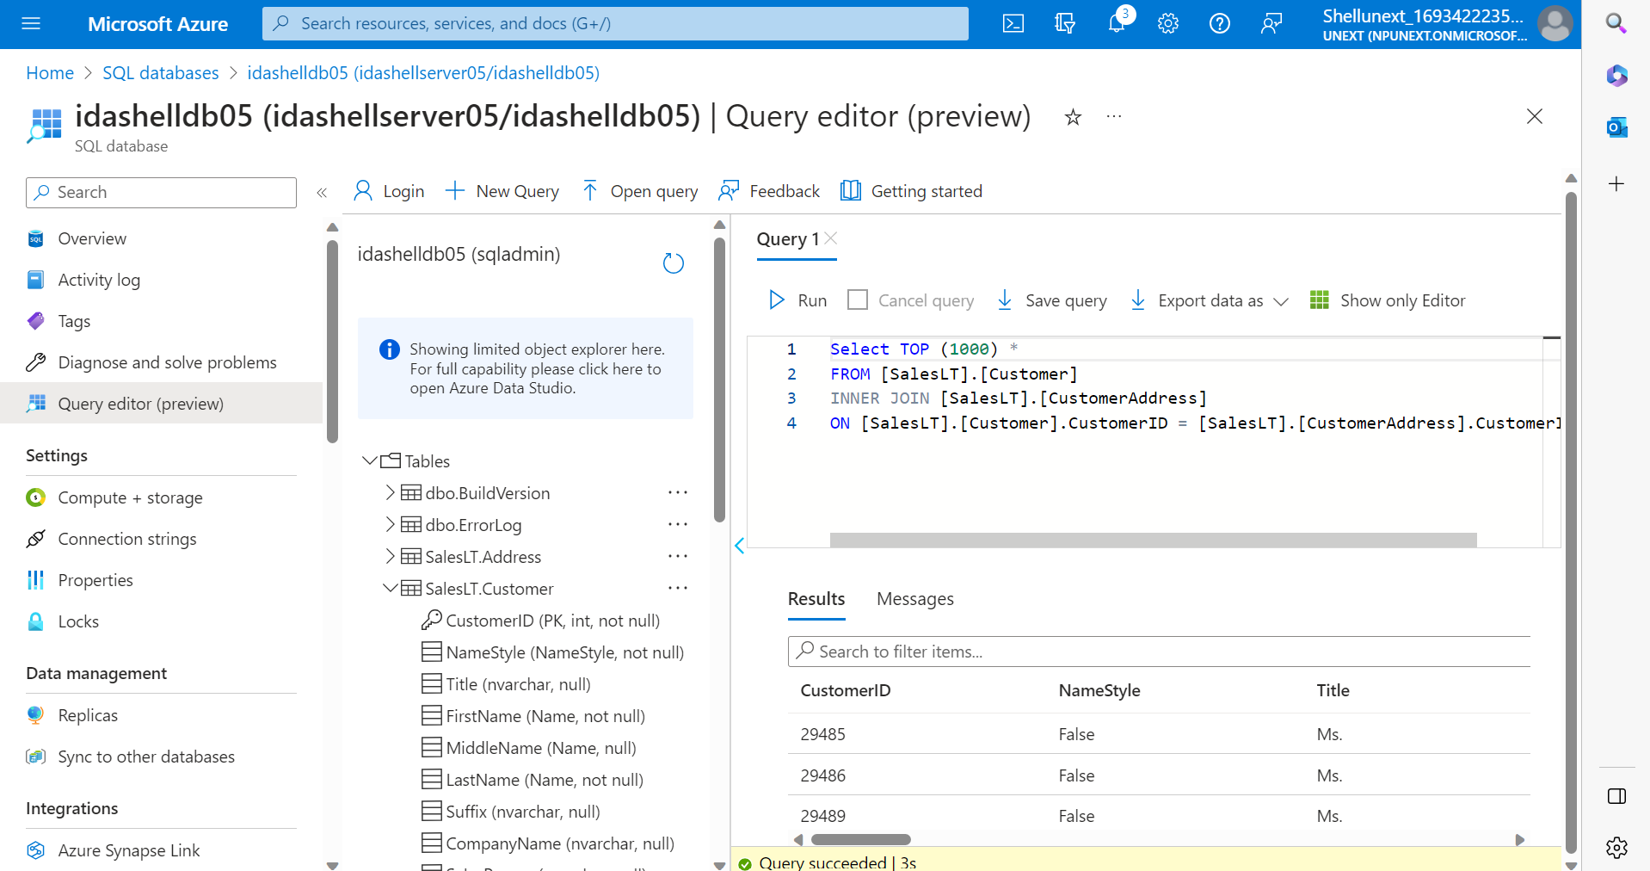
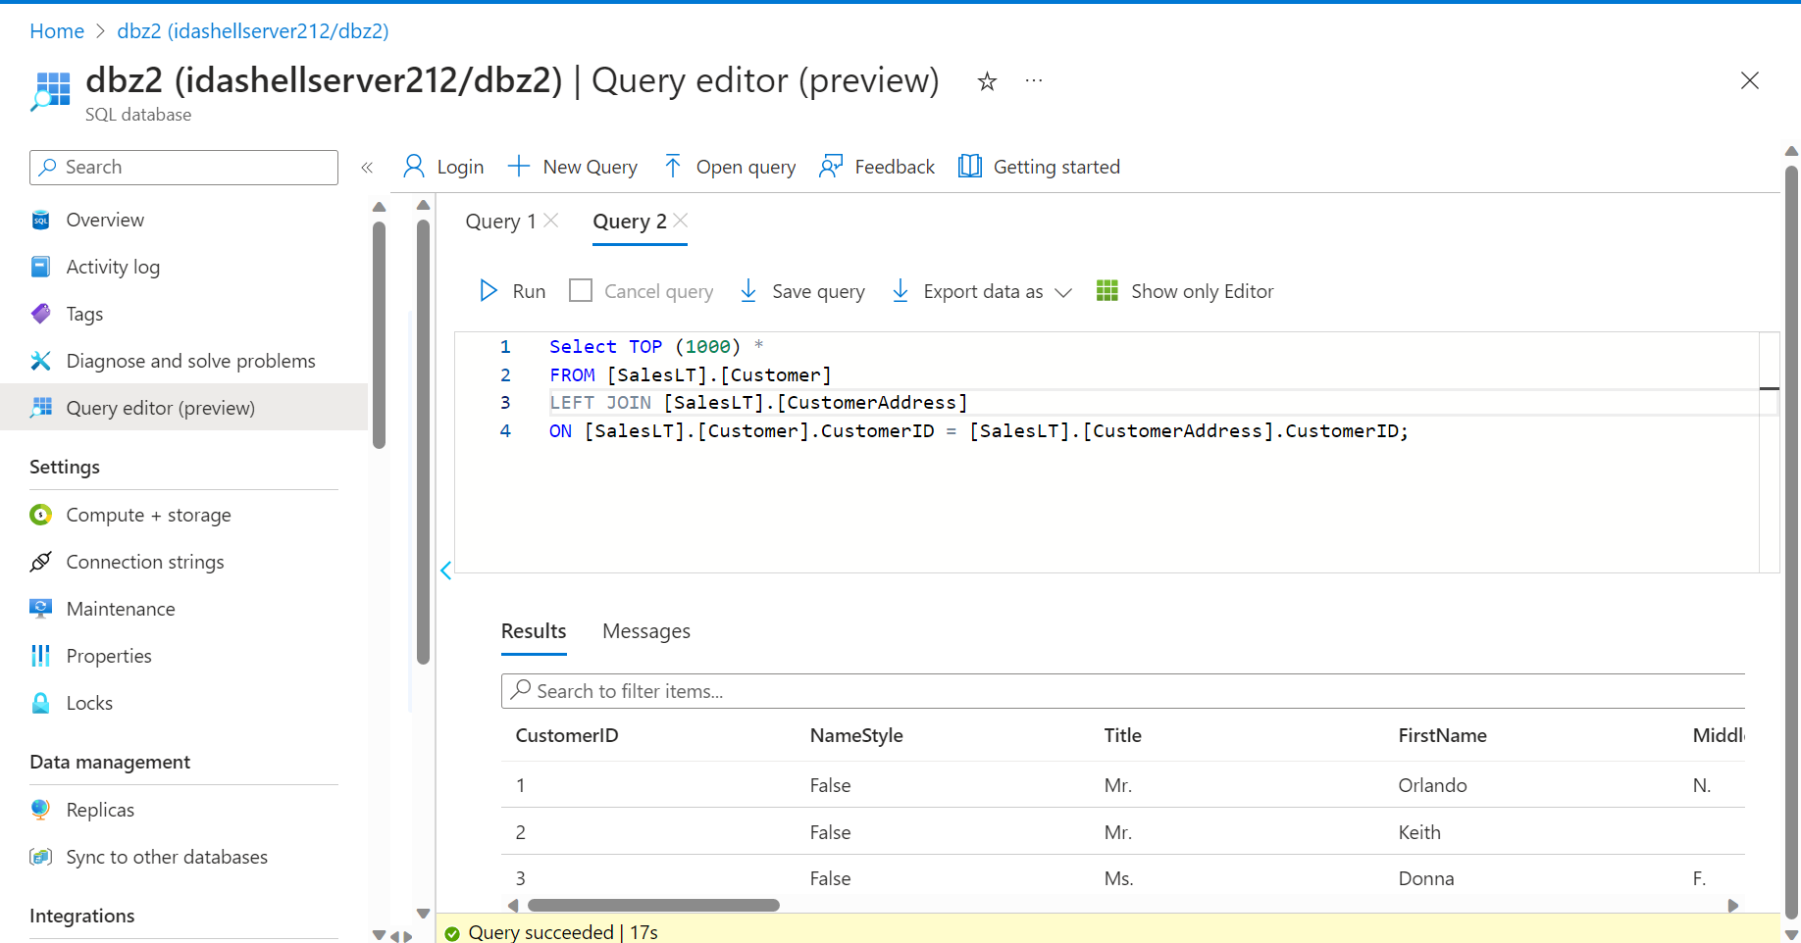
Day 4 – Azure SQL - Joins

Slide 28
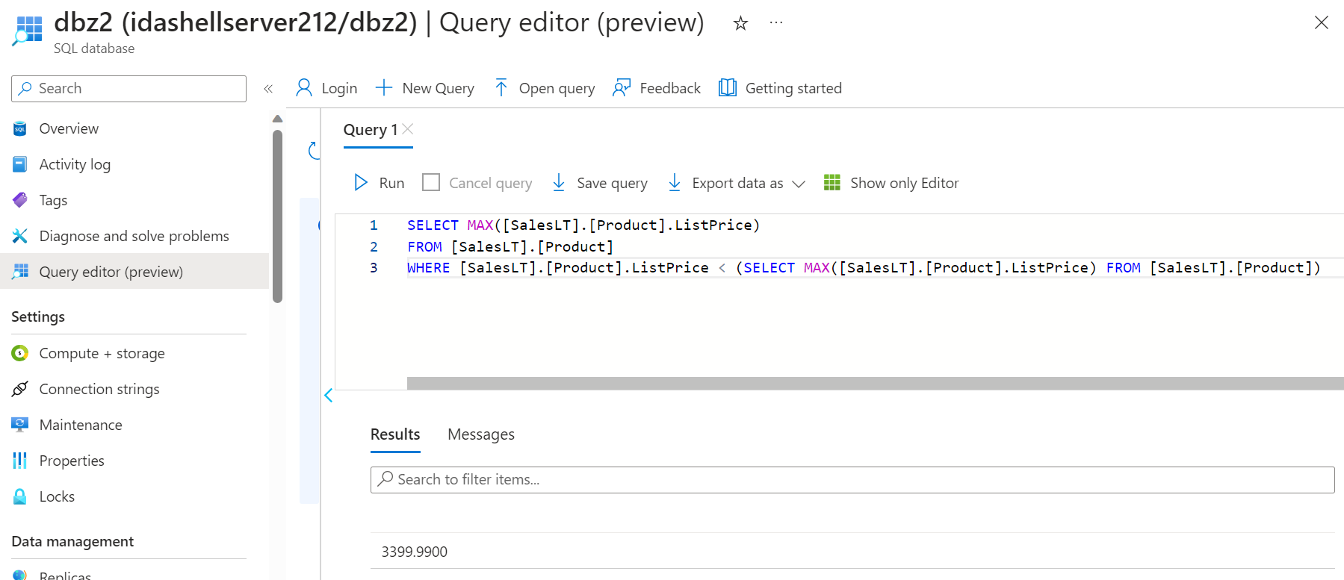
Day 4 – Azure SQL – Sub-Query

Slide 29
Day 5 – 4th September
What is Azure Storage Account
Blob Storage & Data Lake Gen 2 Storage
Types of Redundancy Storage – LSR, GRS, ZRS, GZRS
Types of Access Tiers – Hot, Cool, Cold, Archive
What is Azure File Share
Azure VM – Hands-on
File Share – Hands-on
File Share – Snapshots - Hands-on
Azure Table – Hands-on
Azure Pricing Calculator & TCO Calculator
How to host Static Website on Azure

Slide 30
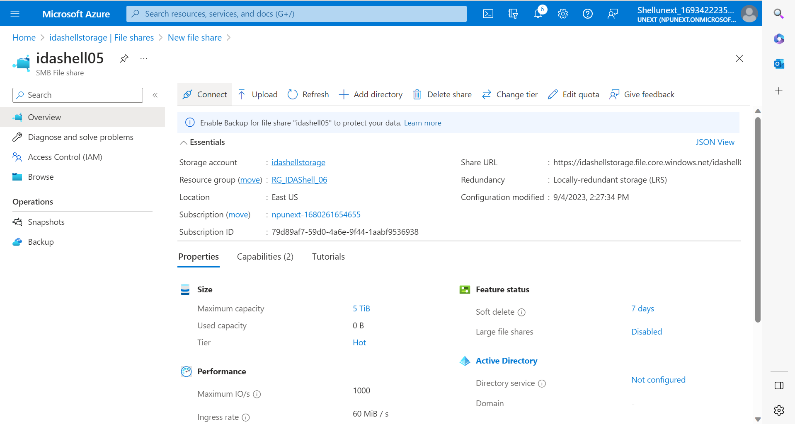
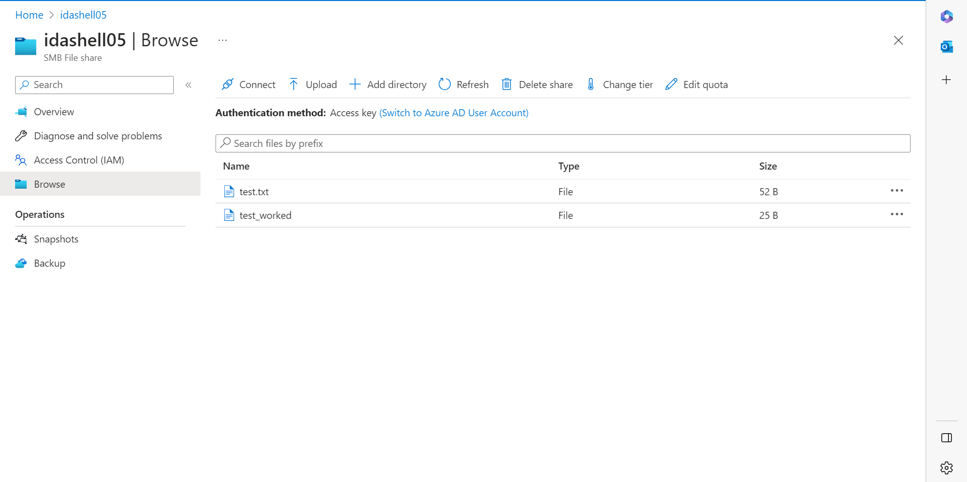
Day 5 – Azure File share

Slide 31
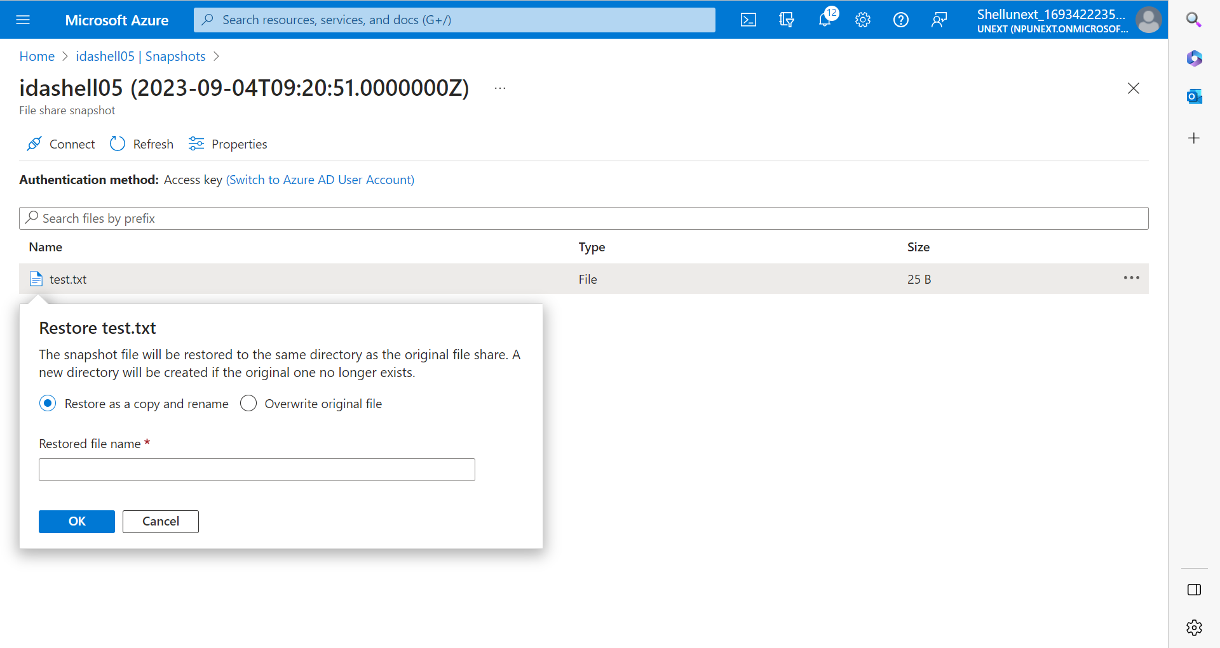
Day 5 – Azure File share - snapshots

Slide 32
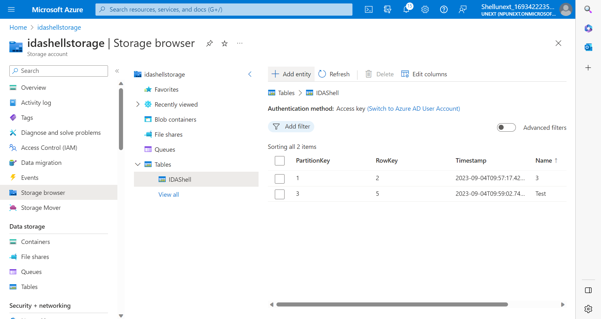
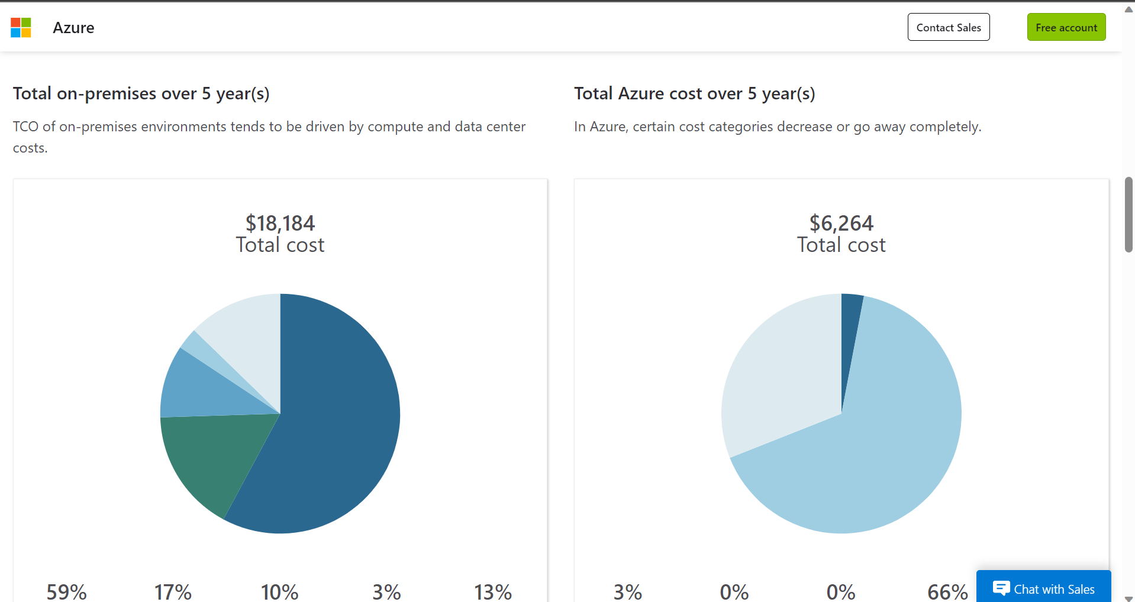
Day 5 – Azure File share – create table and TCO Calculator

Slide 33
Day 6 – 5th September
What is SAS (Shared Access Signature)
Azure Key Vaults
Access Control
Introduction to Azure Data Factory (ADF)
ADF components – pipelines, datasets, linked service, etc.
Parameterization
Introduction to ADF pipelines

Slide 34
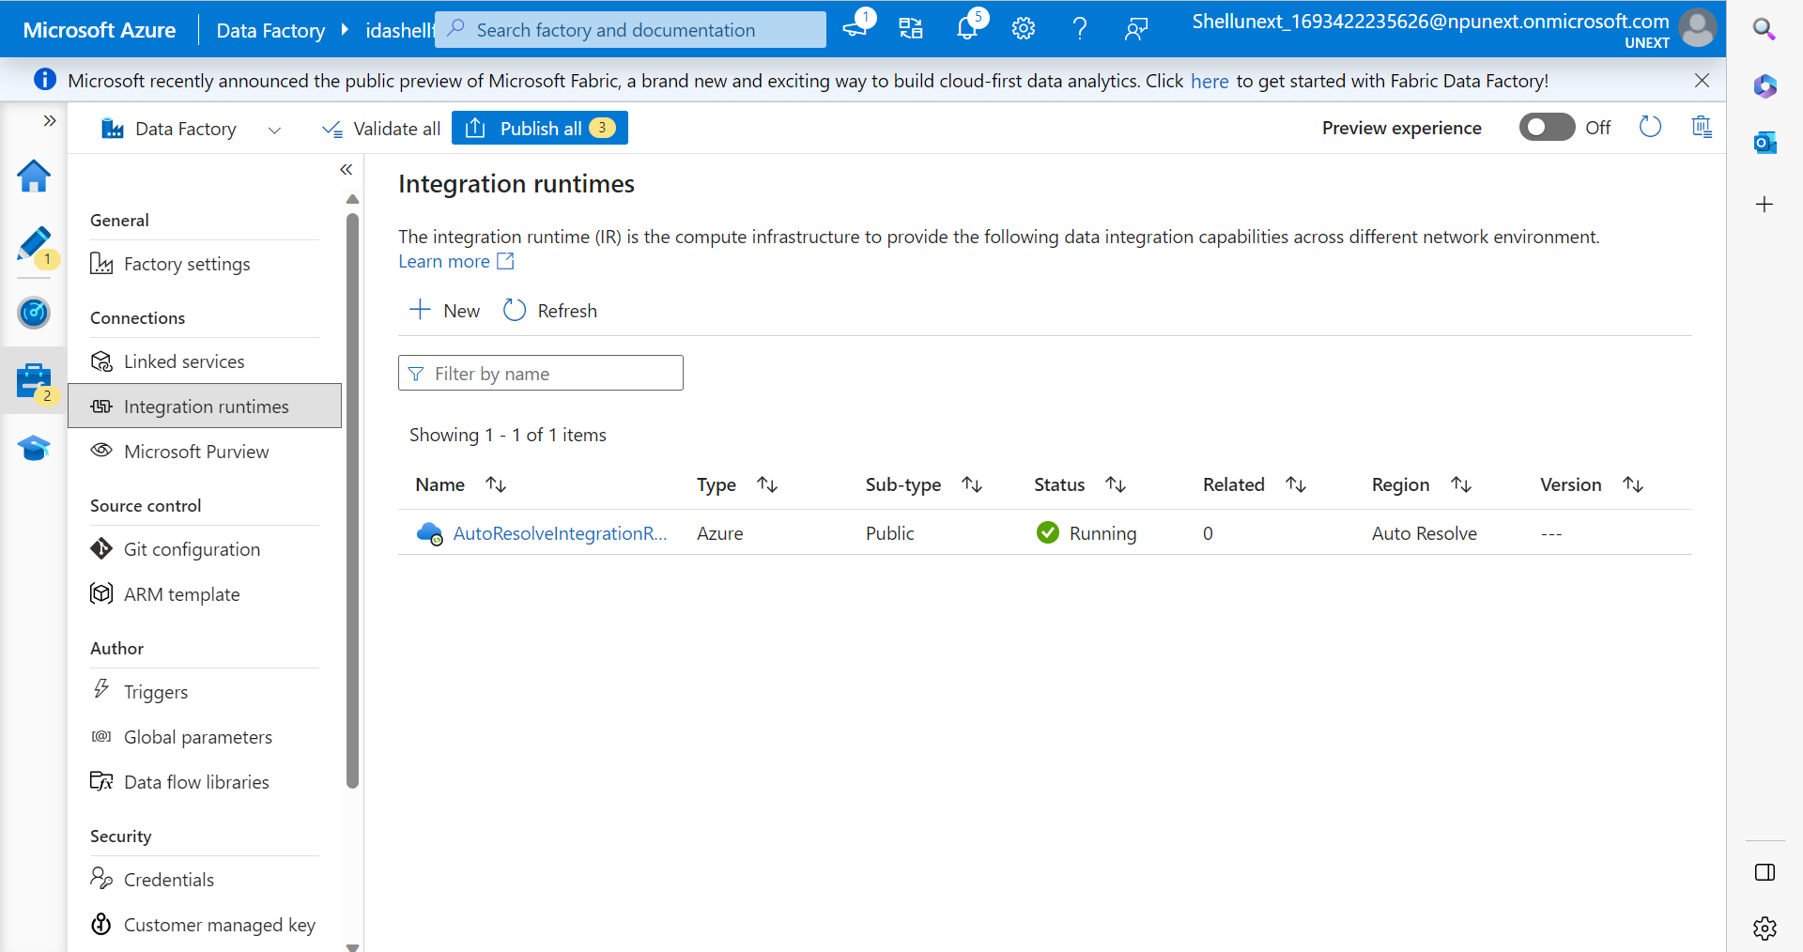
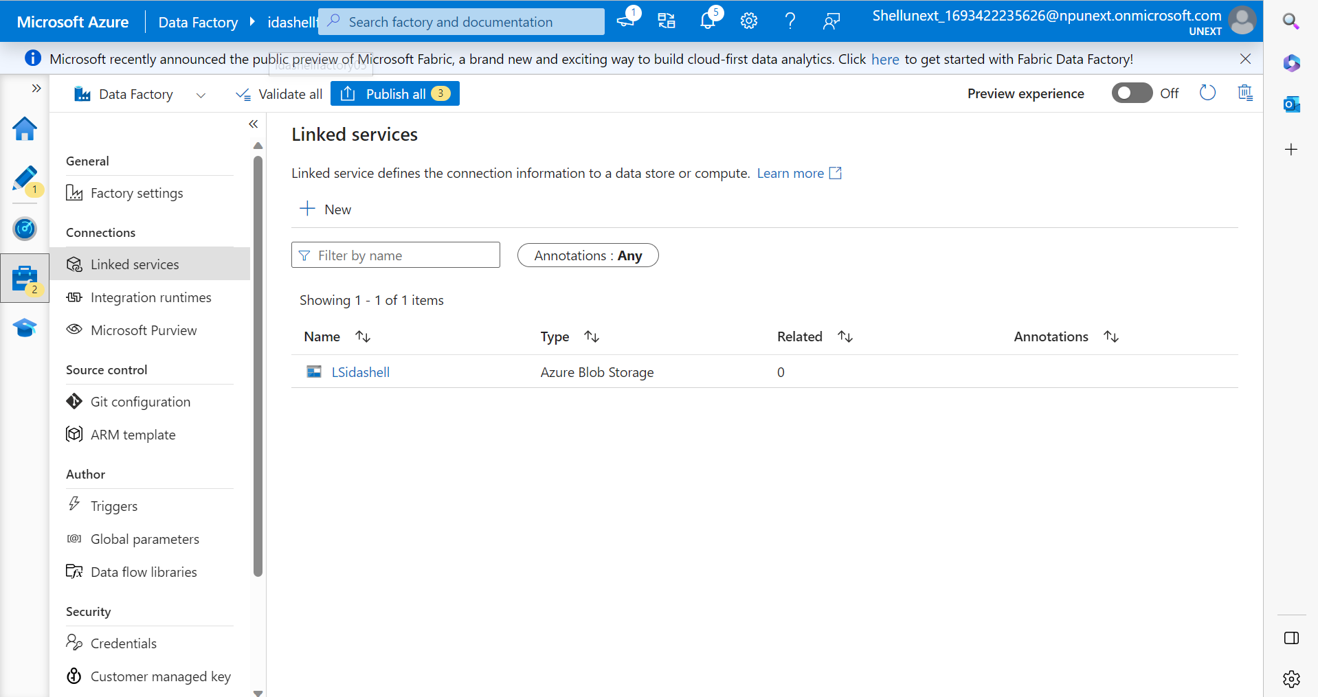
Day 6 – ADF – IR and LS

Slide 35
Day 7 – 6th September
Create ADF
ADF Pipelines – Hands-on
Copy data Activity – Hands-on
Parameterization – Hands-on
What are Triggers
Get Metadata Activity
If-else condition in ADF

Slide 36
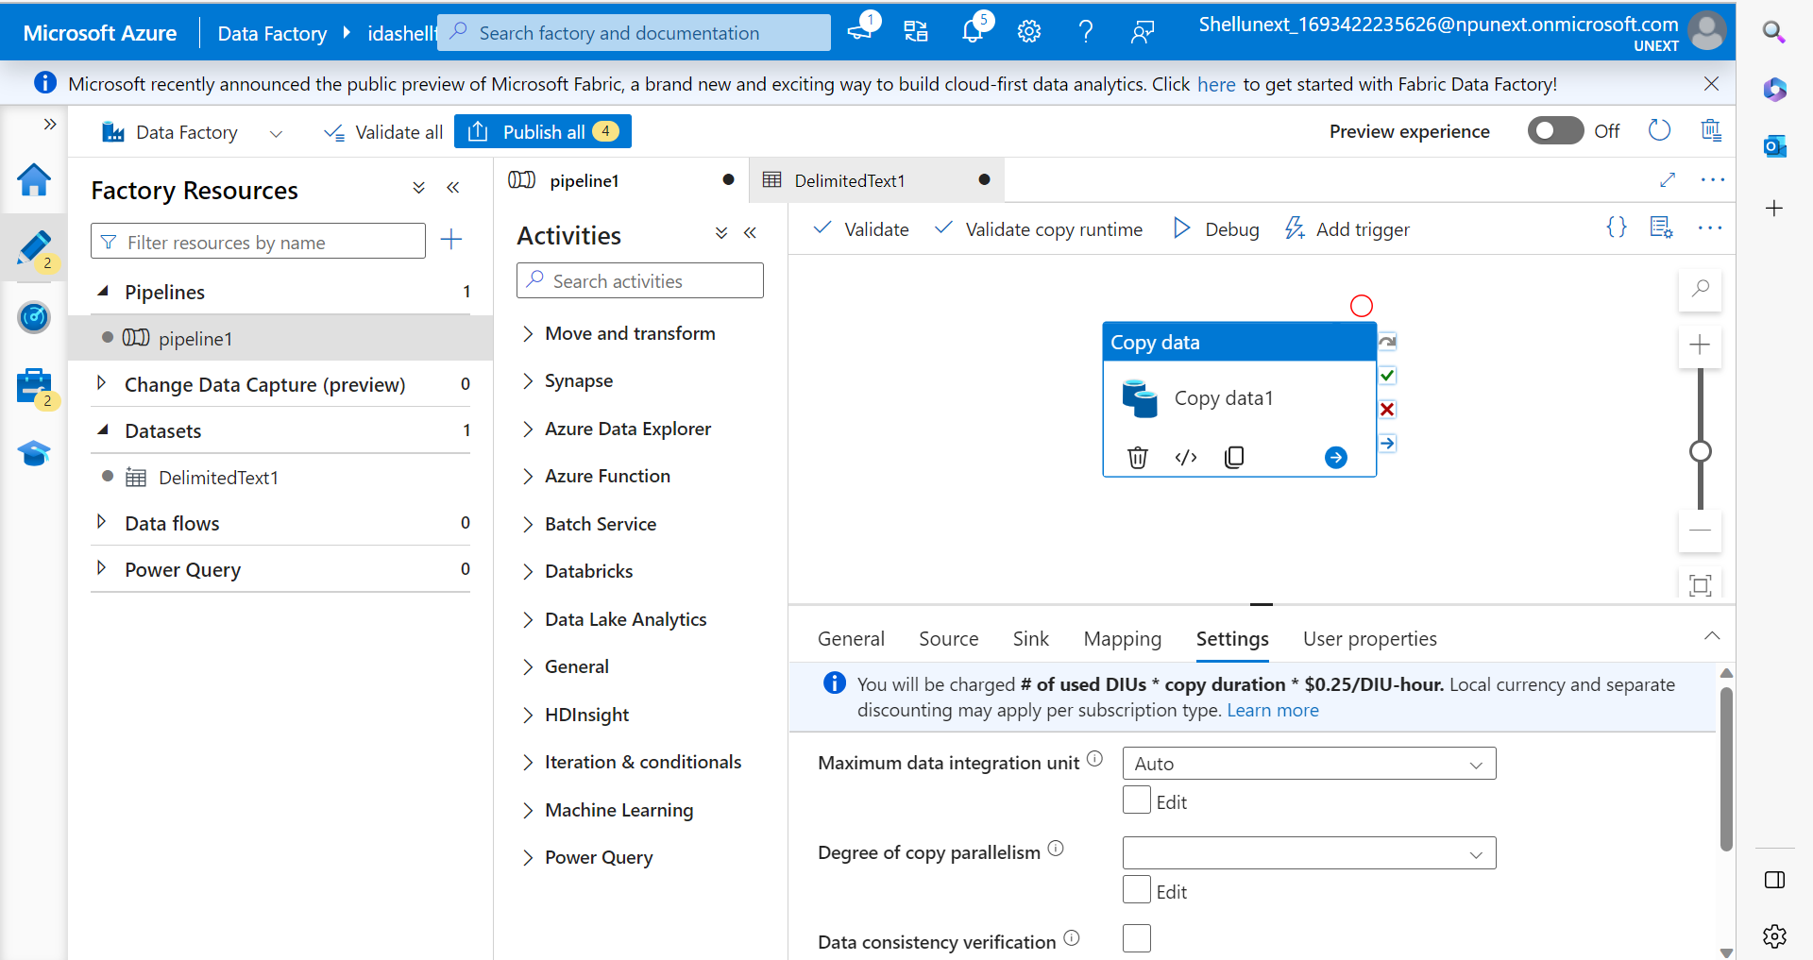
Day 7 – ADF – Pipeline and dataset

Slide 37
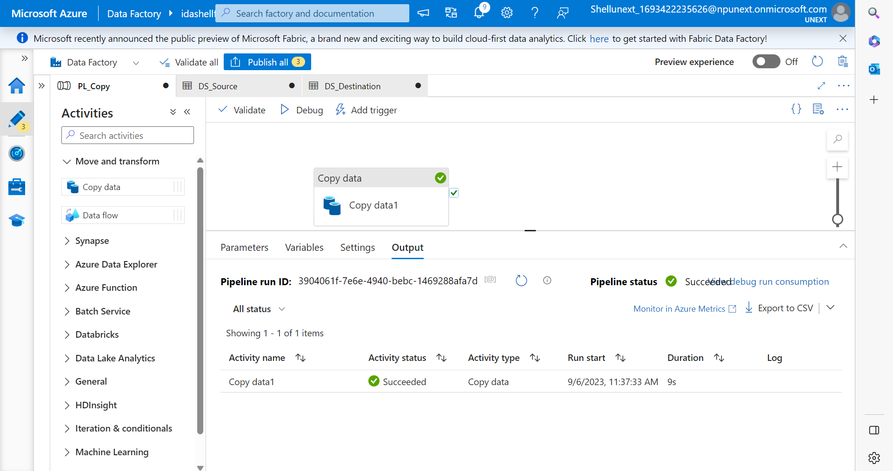
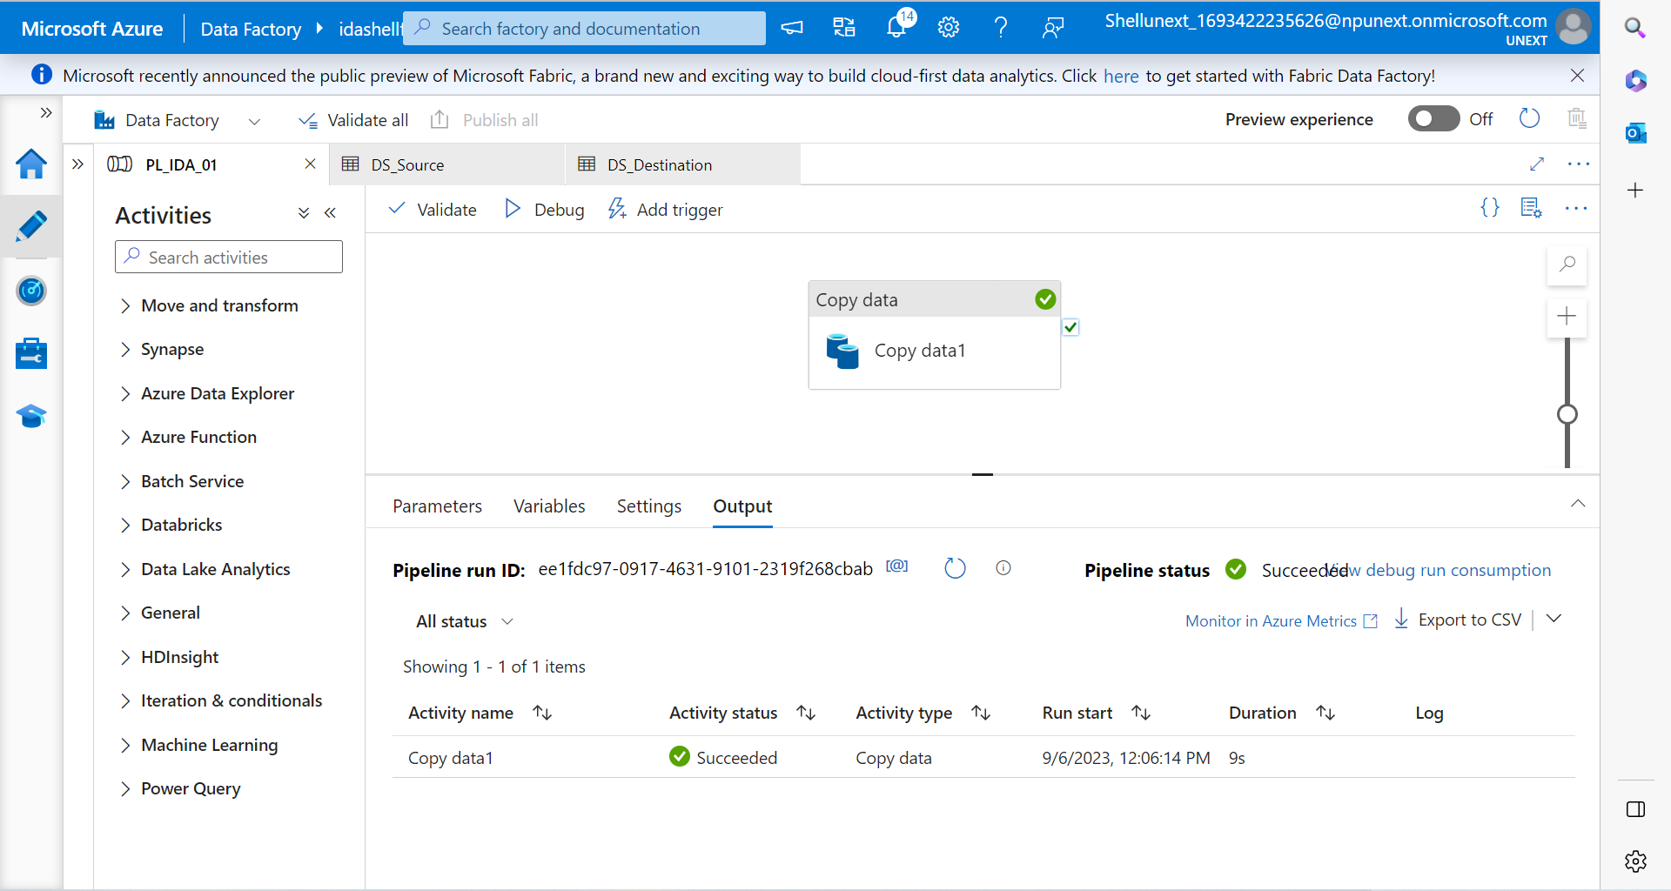
Day 7 – ADF – Copy data and parameters

Slide 38
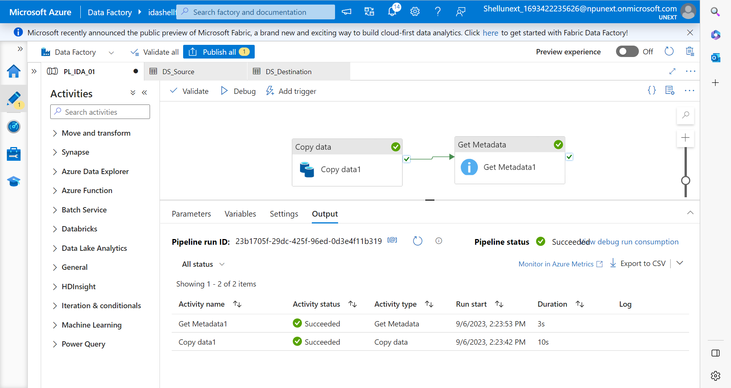
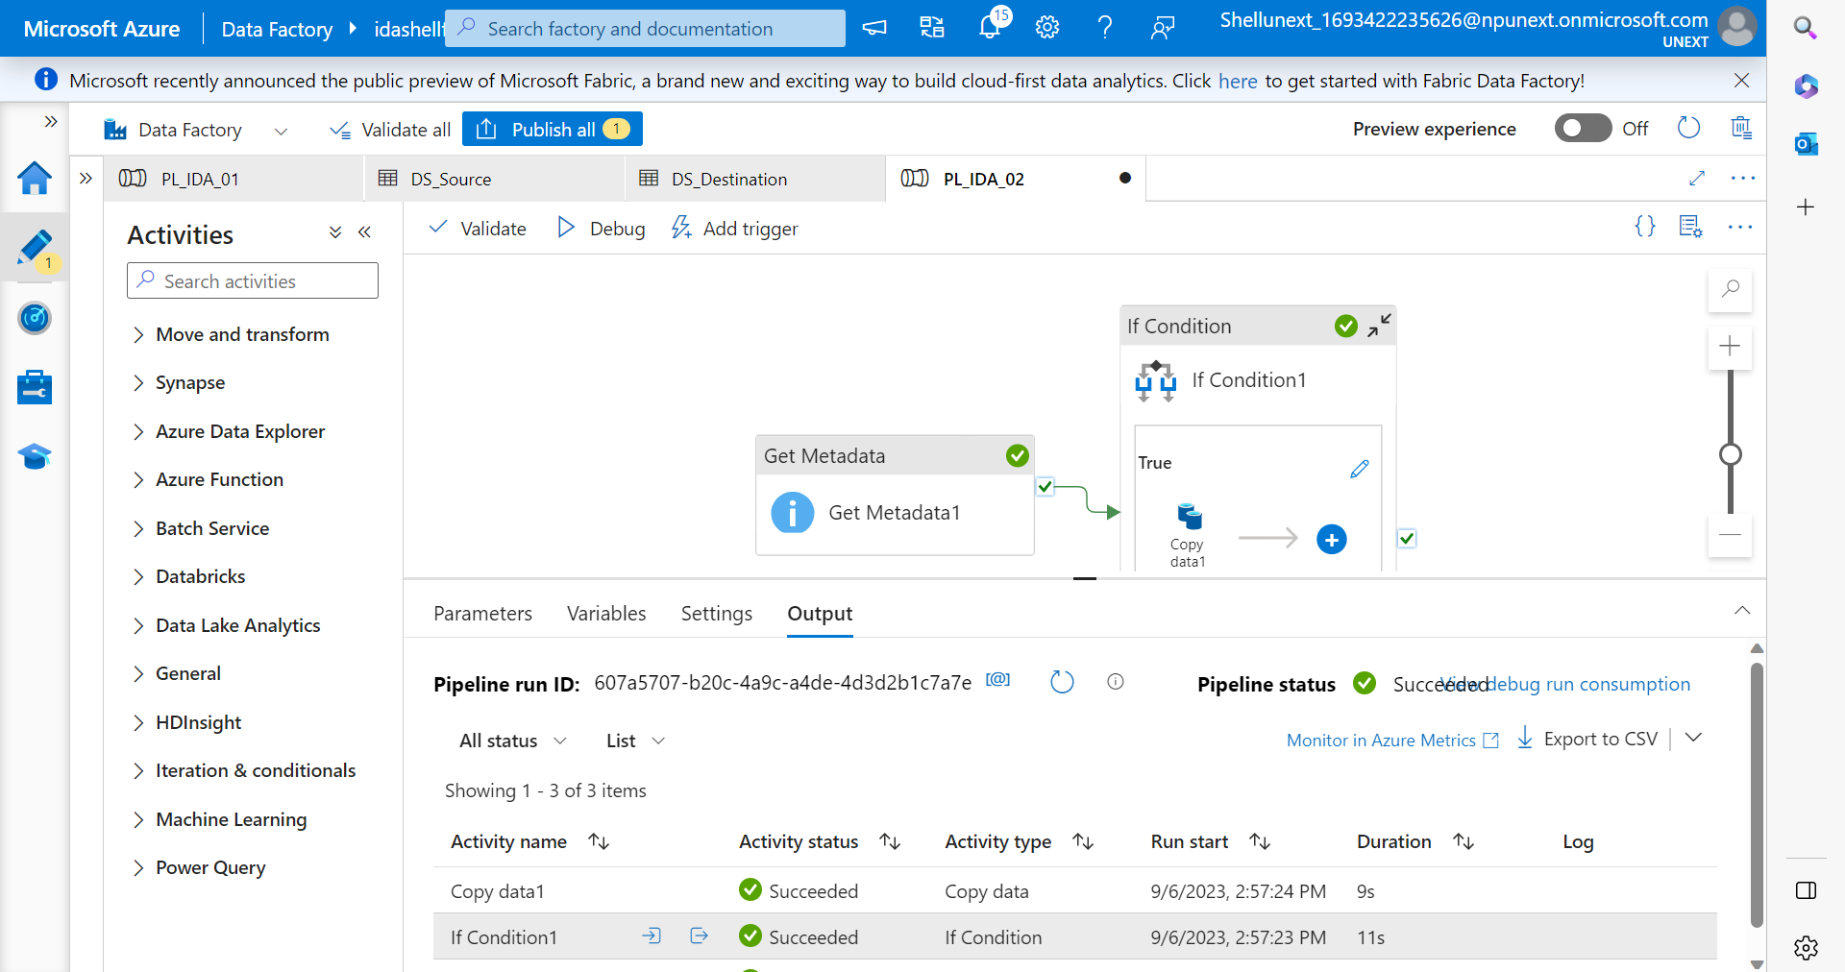
Day 7 – ADF – Get metadata and if-else

Slide 39
Day 8 – 7th September
What are Data Flows
For Each – Hands-on
Data Transformation using Data Flow
Data Flow – Hands-on
What is Surrogate Key
What are APIs

Slide 40
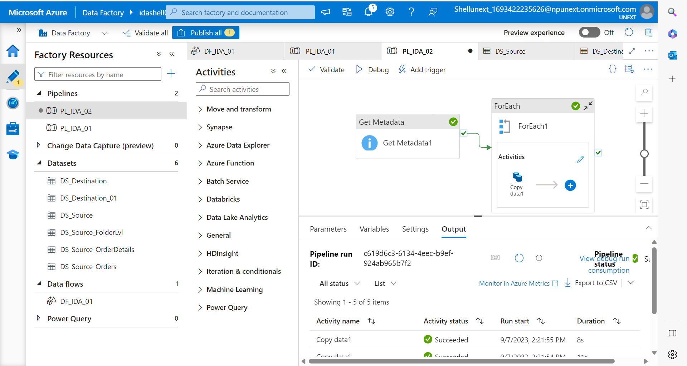
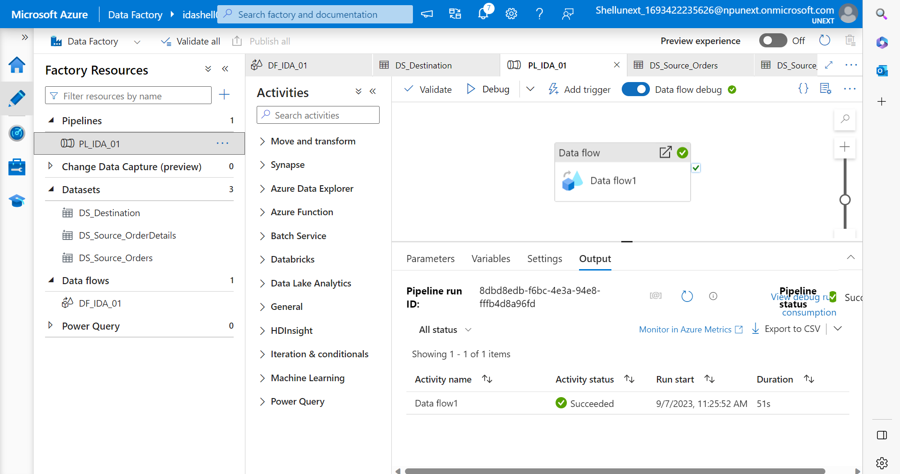
Day 8 – ADF – For each and data flow activity

Slide 41
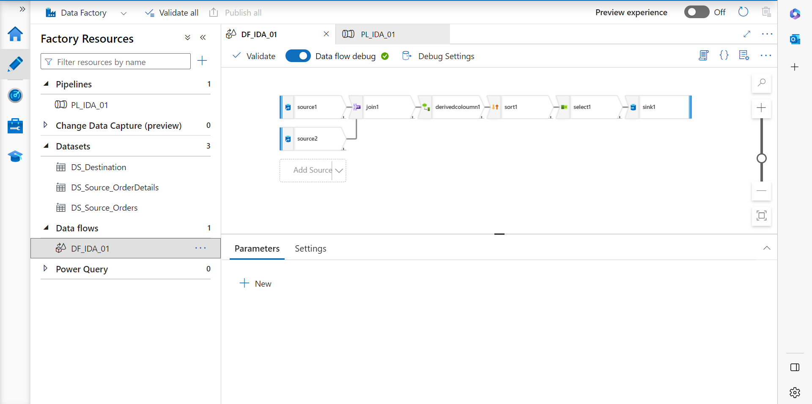
Day 8 – ADF – data flow

Slide 42
Day 9 – 8th September
ADF Lookup Activity – Hands-on
Copy data from API – Hands-on
Copy data from SQL DB to CSV – Hands-on
What is Change Data Capture (CDC)
CDC – Hands-on
What is Automation
Automation using Runbooks

Slide 43
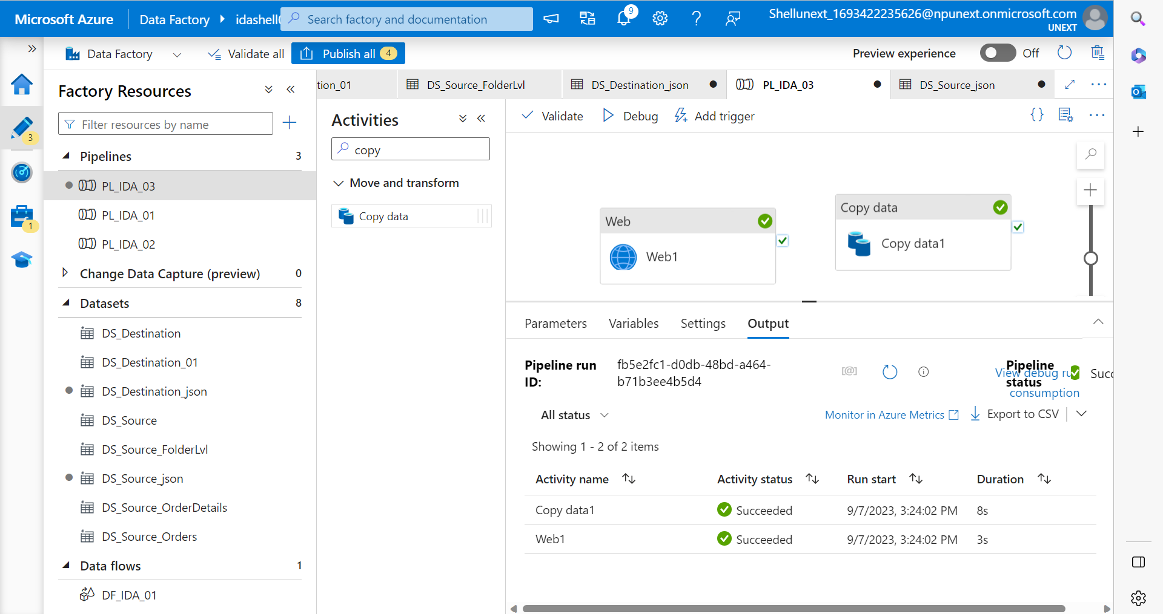
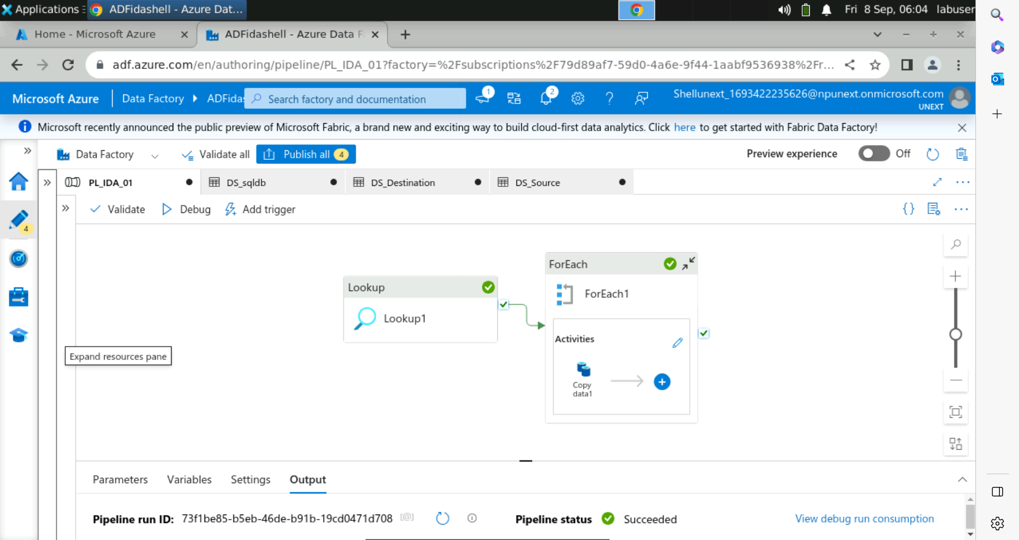
Day 9 – ADF – Copy Data

Slide 44
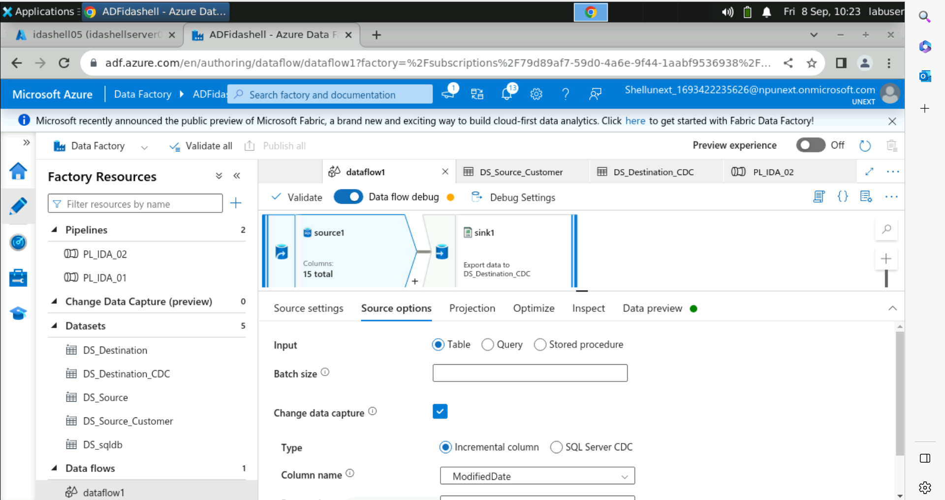
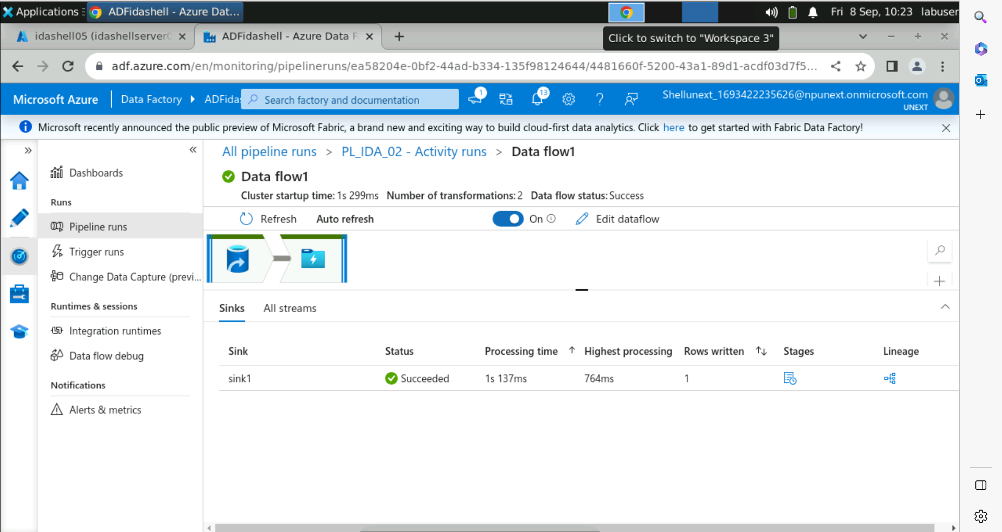
Day 9 – ADF – CDC

Slide 45
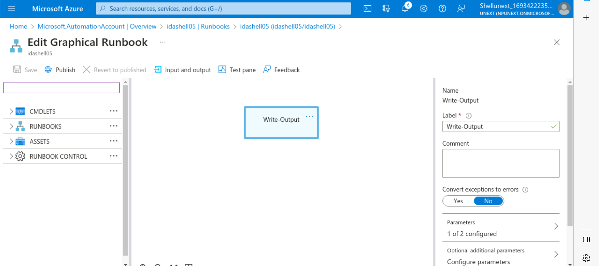
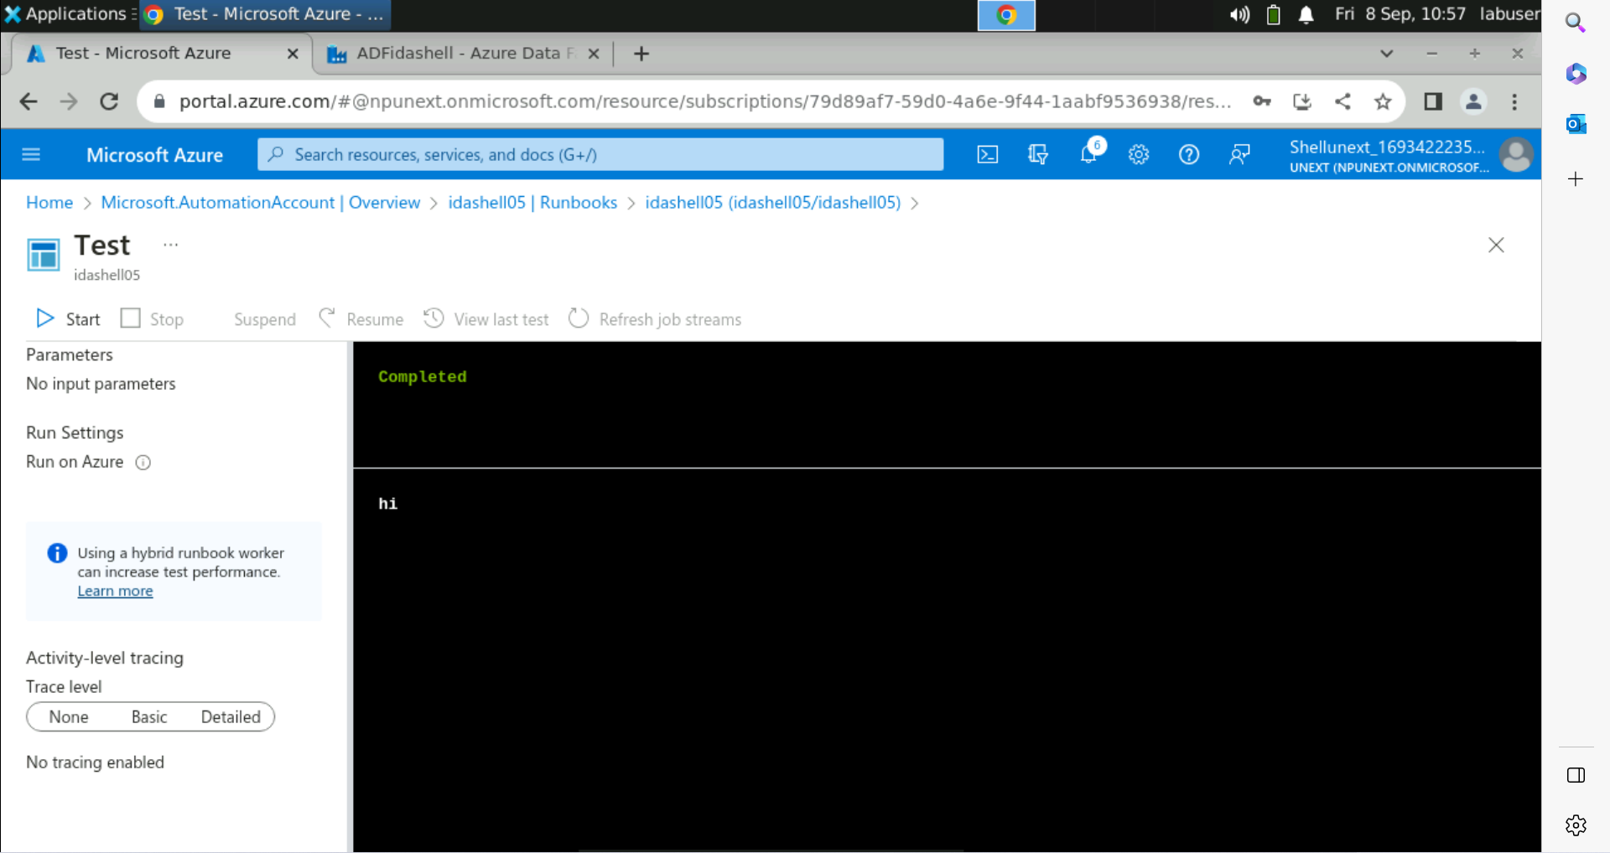
Day 9 – ADF – Runbooks

Slide 46
Day 10 – 11th September
Bangalore Bandh – No class
Doubt session online

Slide 47
Day 11 – 12th September
Azure Synapse
SQL Pool – Serverless and Dedicated
Spark Pool
What is Collate – UTF-8
Common Table Expression (CTE)
Views
What are Hash Distributed Tables
Creating User through SQL Query

Slide 48
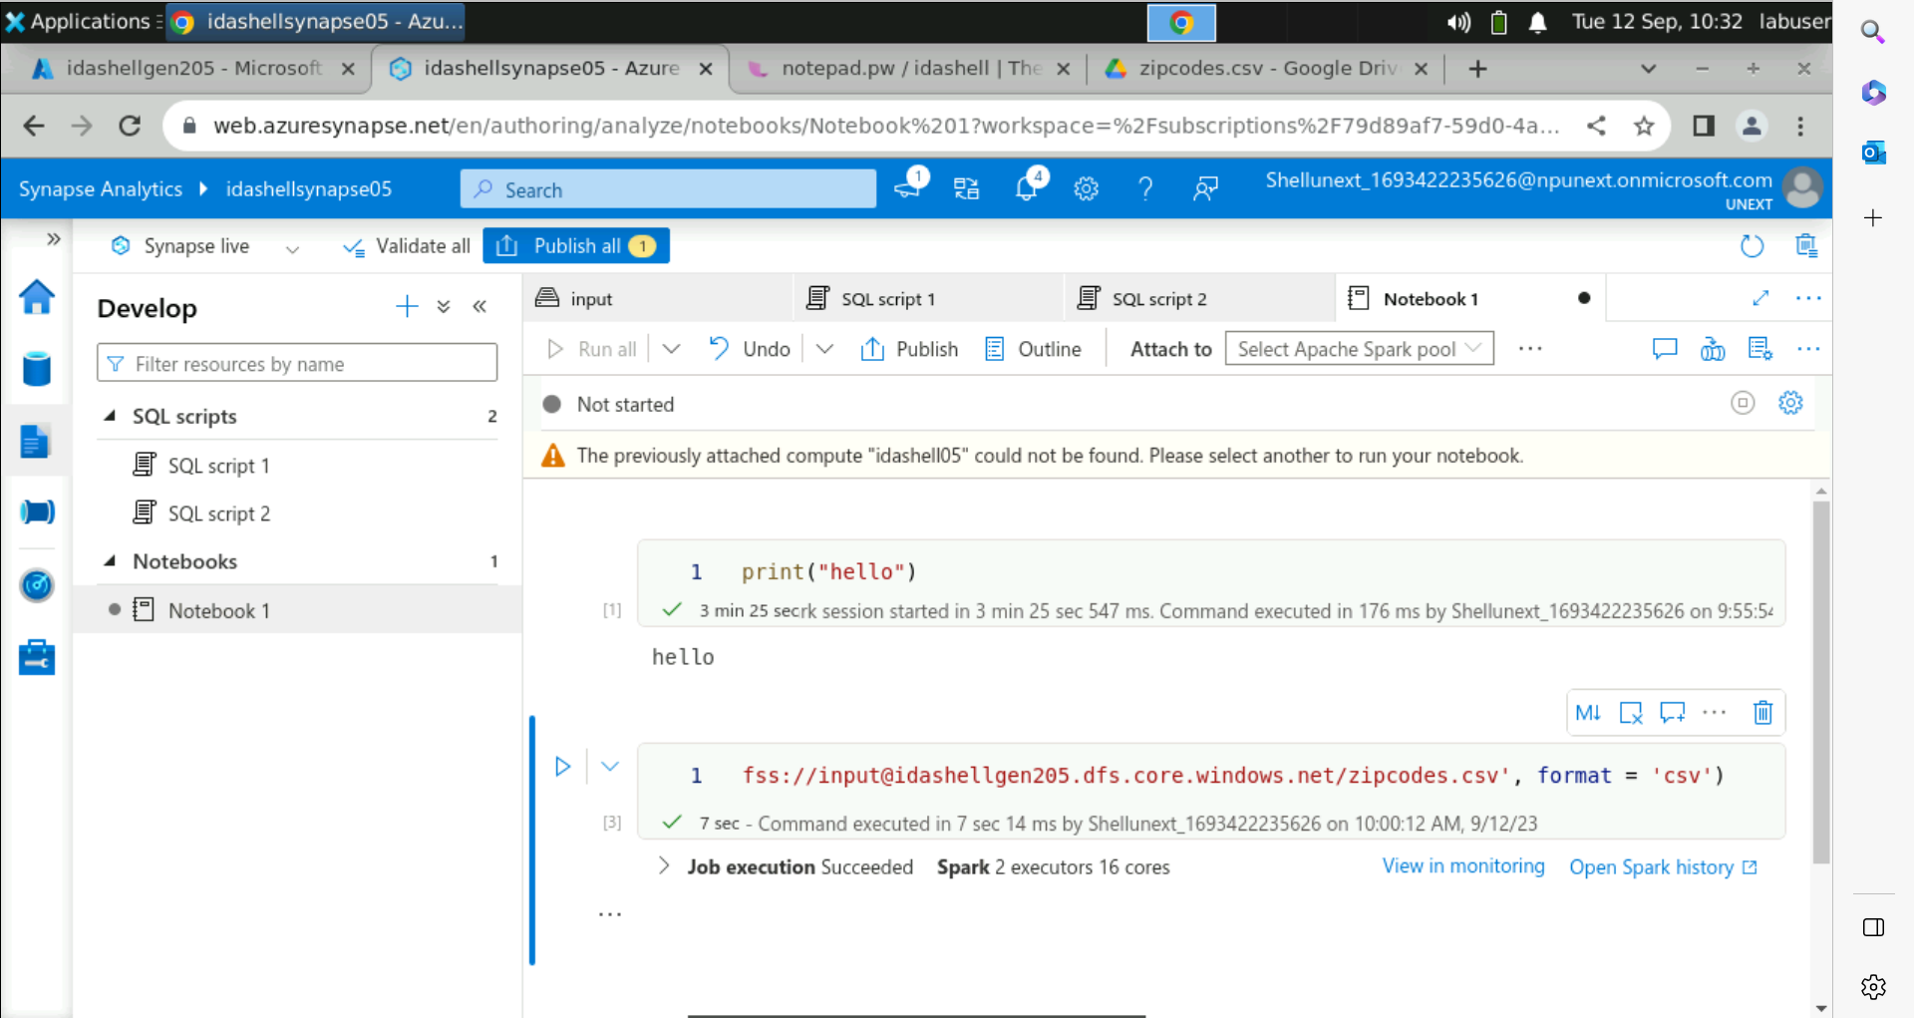
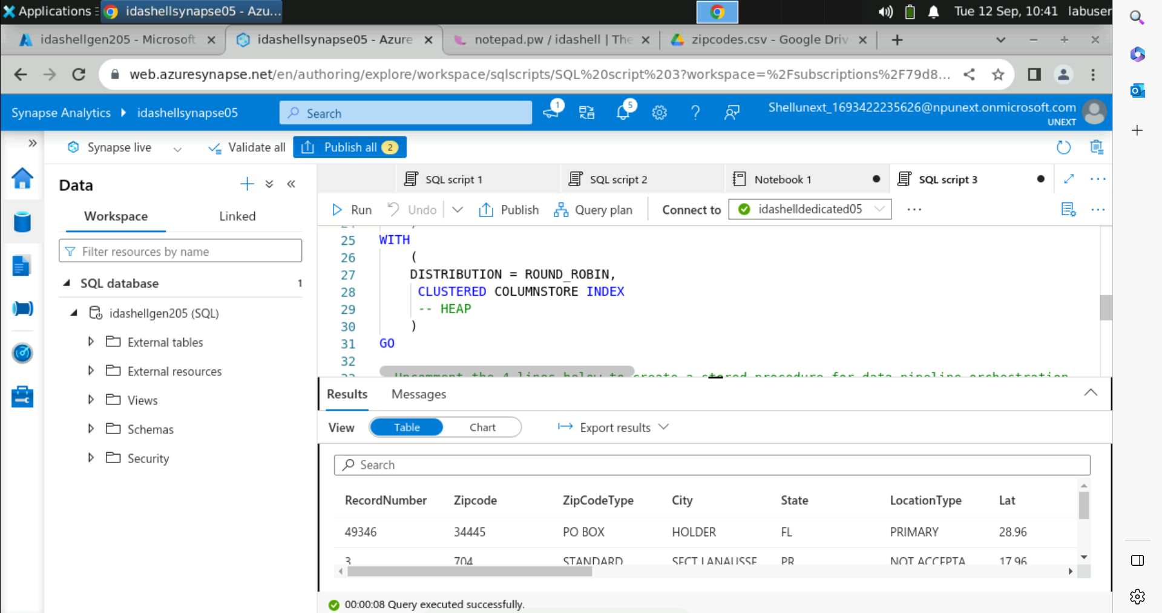
Day 11 – Spark pool and dedicated pool

Slide 49
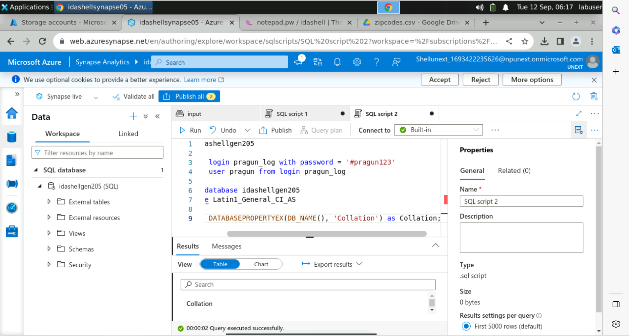
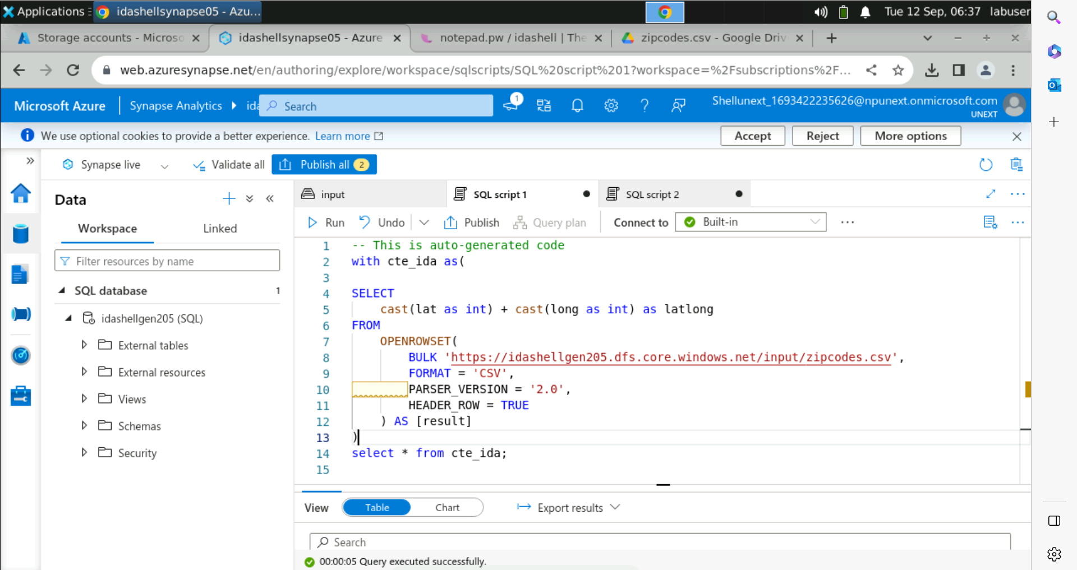
Day 11 – DB collation and CTE

Slide 50
Day 12 – 13th September
Power BI
Power Query Editor
Power BI Visuals
Parameters
Filters – Report level, Page level, Visual level
Slicers
Dax Measures and Columns
Relationships
Row Level Security (RLS)

Slide 51
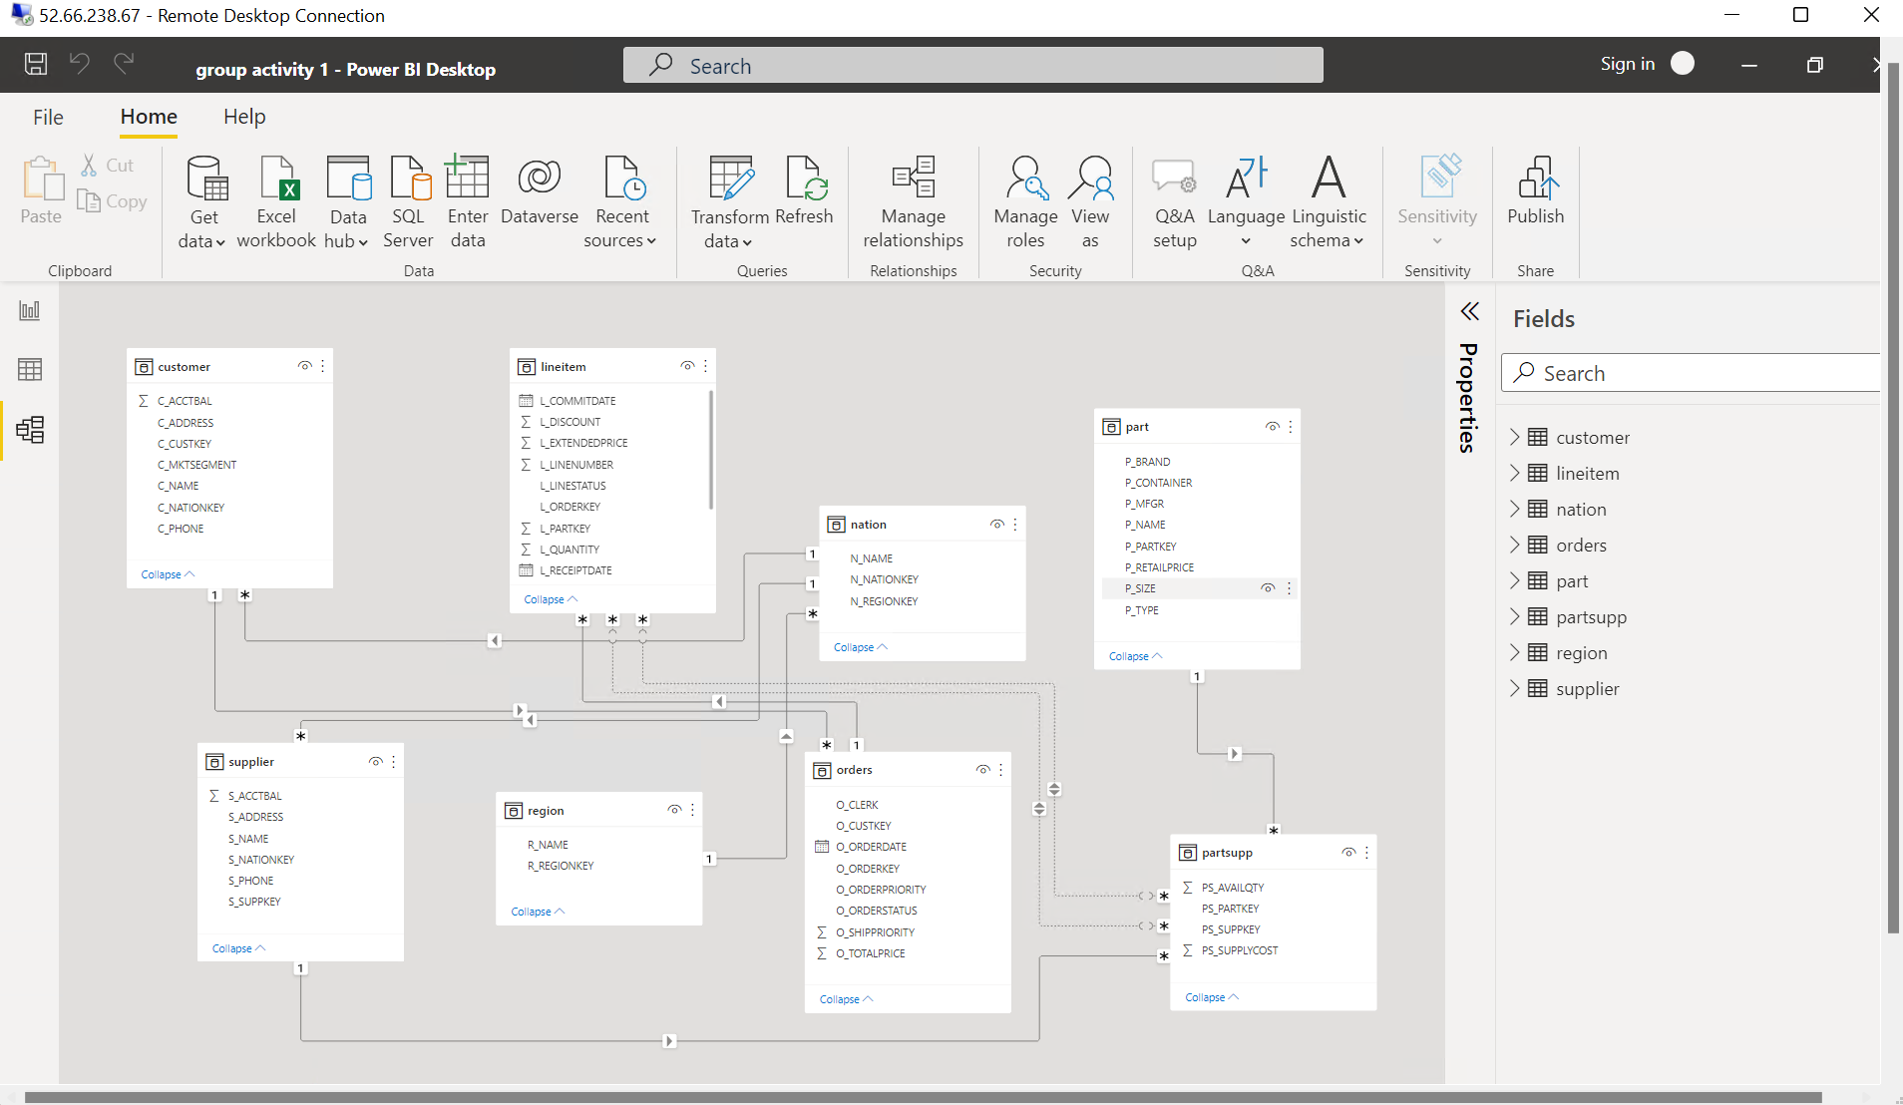

Day 12 – Relationships and parameters

Slide 52


Day 12 – RLS and Dashboard

Slide 53
Day 13 – 14th September
Hands-on Group Activities – Power BI
Drill Through
Date Table
SSMS
Types of Visual – Univariant, Bivariant, Multivariant

Slide 54


Day 13 – Hands-on group activity

Slide 55
Day 14 – 15th September
Hands-on Assessment – Power BI
Python
Jupyter Notebook
Datatypes in Python – Integer, Float, etc.
Operations – Arithmetic, Logical

Slide 56

Day 14 – Hands-on Assessment – Power bi

Slide 57

Day 14 – Python - Datatypes

Slide 58
Day 15 – 19th September
Functions in Python
Recursive and Generator Function
Types of Argument
Classes
Datetime library
Exception Handling
List Comprehension
Lambda Function

Slide 59


Day 15 – Python - Functions

Slide 60

Day 15 – Python – Datetime and exceptions

Slide 61
Day 16 – 20th September
Pandas Library
Dataframes
Pandas Data Transformations – Dropping Null values, changing coloumn to lowercase, etc.
Pandas Commands – describe, show, etc.
Matplotlib
Arrays in Python

Slide 62


Day 16 – Python – pandas

Slide 63
Day 17 – 21st September
Lazy Evaluation
PySpark
PySpark Commands – Read file, Write file, etc.
Resilient Distributed Dataset (RDD)
Caching
RDD vs Dataframe
Deployment Types – Client Mode and Cluster Mode

Slide 64


Day 17 – Python – pYSpark

Slide 65
Day 18 – 22nd September
Partitioning
Spark UI URL
SQL in PySpark
When – Otherwise Condition
User Defined Schema
Caching
Joins
Group By

Slide 66


Day 18 – Python – pYSpark – Partitions and join

Slide 67


Day 18 – Python – pYSpark – UDF Schema and SQL

Slide 68
Day 19 – 25th September
Caching
Persist and different Storage Levels
Aggregation
Managed and External Tables
-- Only 4 hours training due to OneIDA Event.

Slide 69
Day 20 – 26th September
What is Databricks
Setting up Azure Databricks
Cluster Configuration
Mounting
Widgets
Parameters
Functions
%run, %md, %language
Structured Streaming

Slide 70


Day 20 – Databricks

Slide 71
Day 21 – 27th September
-- I was absent.
What was done:
Structured Streaming
Delta Table and Parquet Table
Medallion / Multi-hop architecture
Unity Catalog in Databricks
Metastore

Slide 72
Day 22 – 28th September
What is Docker
Docker initialization in VM
Build Docker Image – App, Requirement.txt, DockerFile
Docker Push
Azure Container Registry (ACR)
Kubernetes
Azure Kubernetes Services (AKS)
Deploy a single-image application using code and UI.

Slide 73


Day 22 – Docker

Slide 74


Day 22 – Single-image app through UI

Slide 75
Day 23 – 29th September
What is Devops
Azure Devops – Boards, Repos, Pipelines, Test Plans
Work Items – Epic, Feature, User Story, Task, etc.
Azure Devops Handson
Azure Repos
Azure Pipelines

Slide 76


Day 23 – Devops

Slide 77
Day 24 – 3rd October
What is Machine Learning
Types of Machine Learning Algorithms – Supervised, Unsupervised, Semi-Supervised, Reinforcement
Overview of Azure ML Studio
Creating and running Pipelines in ML Studio

Slide 78

Day 24 – Azure ml studio

Slide 79
Day 25 – 4th October
Creating Pipelines with HyperParameters
Automated ML
Azure ML Hands-on Assessment
Start of the Final Case Study

Slide 80


Day 25 – Azure ml studio

Slide 81


